Slide 1
Joining the UN Sustainable Development Goals Publishers Compact

Slide 2
What are the UN Sustainable Development Goals?

Slide 3
What is the Publishers Compact?
The Compact is designed to inspire action among publishers. Launched in collaboration with the International Publishers Association, the Compact aims to accelerate progress to achieve the Sustainable Development Goals (SDGs) by 2030.
How we publish, how we work with suppliers, how we set up workflows and processes in a sustainable way; and
What we publish, what content carries the information needed by different audiences and has the potential to deliver real-life impact.

Slide 4
How we publish: What is the current status of our organisation?
Do we have a written environmental policy?
Have we evaluated our carbon footprint?
Have we committed to net zero?
Do we have written DEIA pledges and policies?
Do we have a modern slavery act policy?
Is your organisation involved with Research4Life (R4L)?
Do your articles include plain language summaries or bullets on practical applications to translate research into action?
Does your organisation make Corporate Responsibility/ESG reports public?

Slide 5
What we publish
Actively promoting and acquiring content that advocates for themes represented by the SDGs, such as equality, sustainability, justice and safeguarding and strengthening the environment.
Dedicating budget and other resources towards accelerating progress for SDG-dedicated projects and promoting SDG principles.

Slide 6
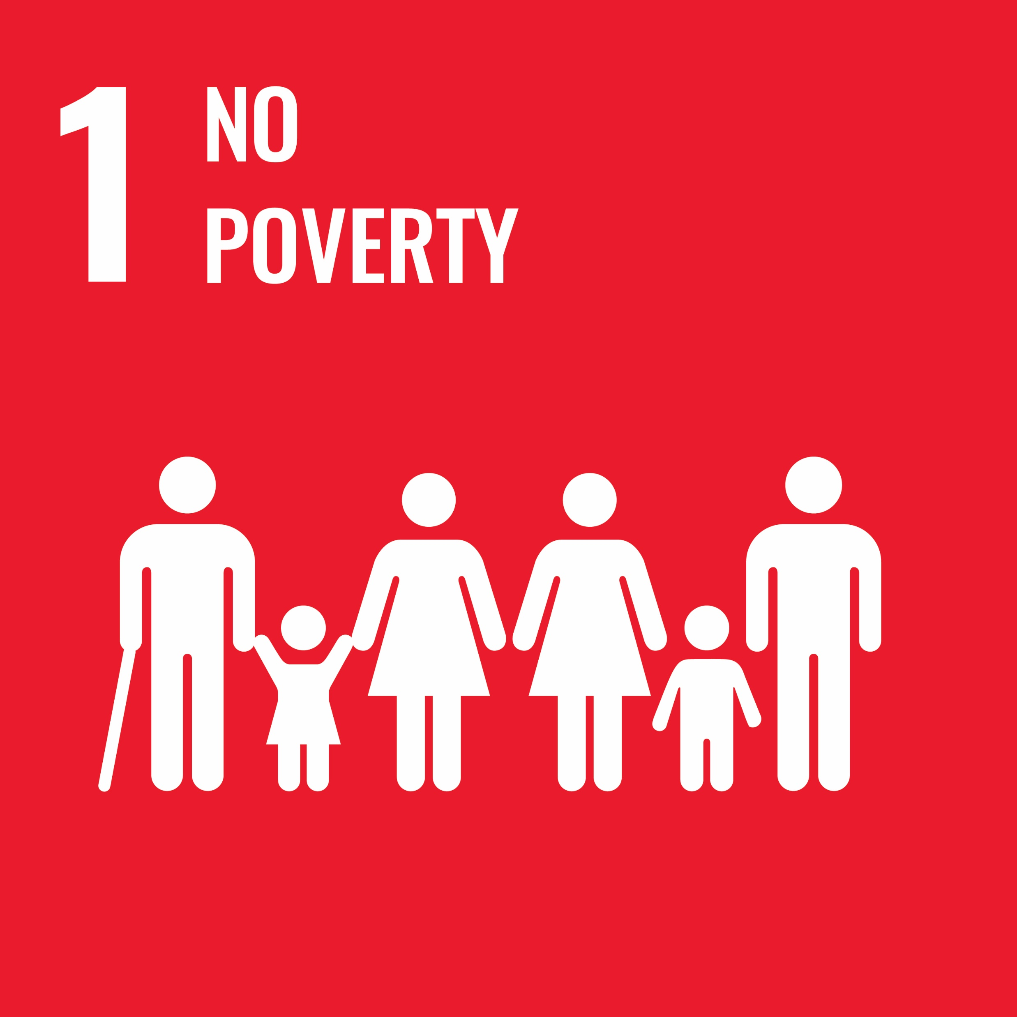
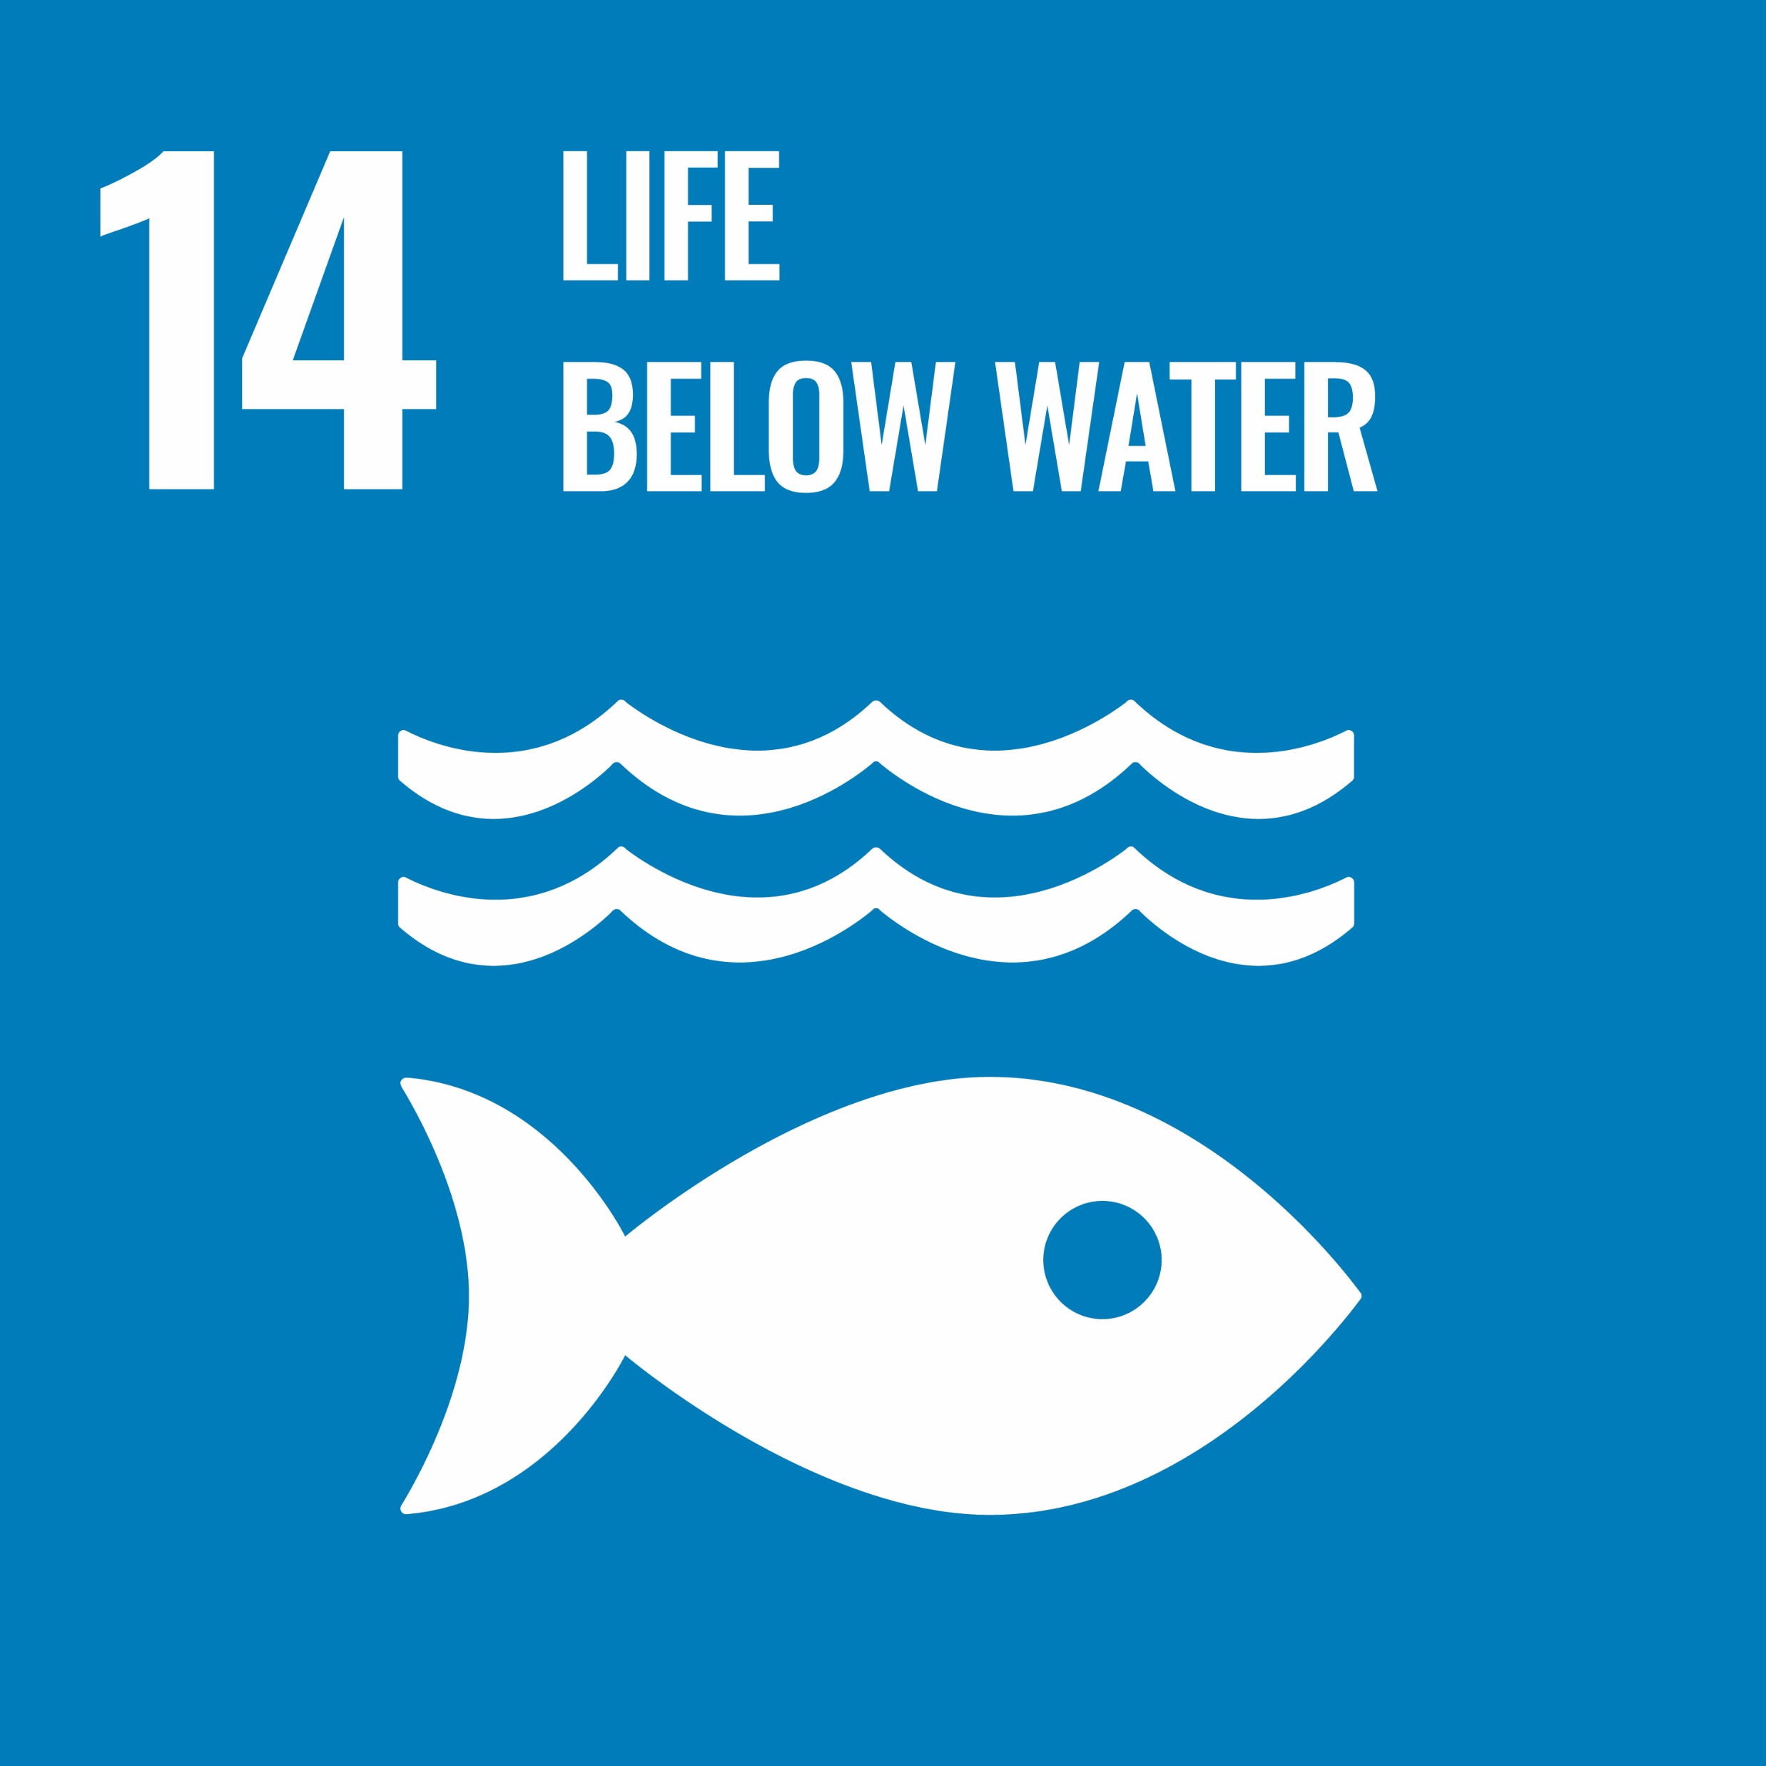
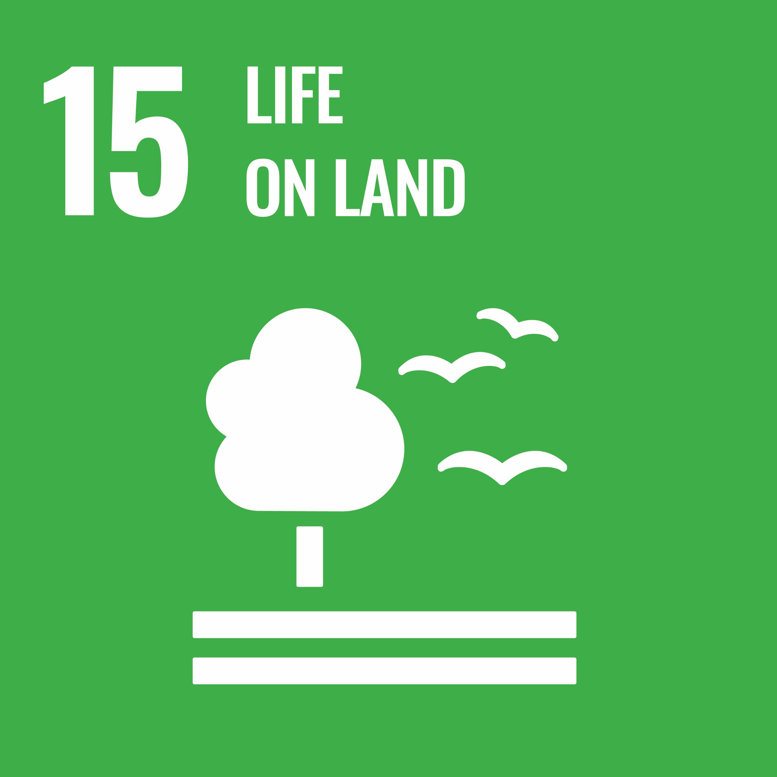
Signing up & 1st steps
Review the compact
Assign a lead contact and a team with appropriate responsibilities
Sign the compact and publicise
Use the STM Academic Publishers Forum toolkit to review internal practices
Review activities of other signatories to promote SDGs through content
Begin to implement the commitments of the compact

Slide 7
The Publishers Compact 10 Commitments
1. Committing to the SDGs: Stating sustainability policies and targets on our website, including adherence to this Compact; incorporating SDGs and their targets as appropriate.
2. Actively promoting and acquiring content that advocates for themes represented by the SDGs, such as equality, sustainability, justice and safeguarding and strengthening the environment.
3. Annually reporting on progress towards achieving SDGs, sharing data and contribute to benchmarking activities, helping to share best practices and identify gaps that still need to be addressed.
4. Nominating a person who will promote SDG progress, acting as a point of contact and coordinating the SDG themes throughout the organization.
5. Raising awareness and promoting the SDGs among staff to increase awareness of SDG-related policies and goals and encouraging projects that will help achieve the SDGs by 2030.
6. Raising awareness and promoting the SDGs among suppliers, to advocate for SDGs and to collaborate on areas that need innovative actions and solutions.
7. Becoming an advocate to customers and stakeholders by promoting and actively communicating about the SDG agenda through marketing, websites, promotions and projects.
8. Collaborating across cities, countries, and continents with other signatories and organizations to develop, localize and scale projects that will advance progress on the SDGs individually or through their Publishing Association.
9. Dedicating budget and other resources towards accelerating progress for SDG-dedicated projects and promoting SDG principles.
10. Taking action on at least one SDG goal, either as an individual publisher or through your national publishing association and sharing progress annually.

Slide 8
Examples of Reporting
IOS Press Looking to the Future Report
OUP Responsible Publishing Report

