Slide 1
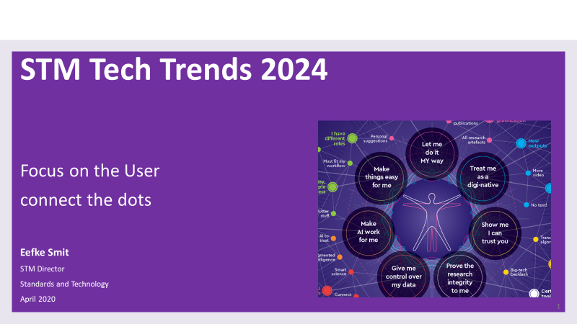



Slide 2
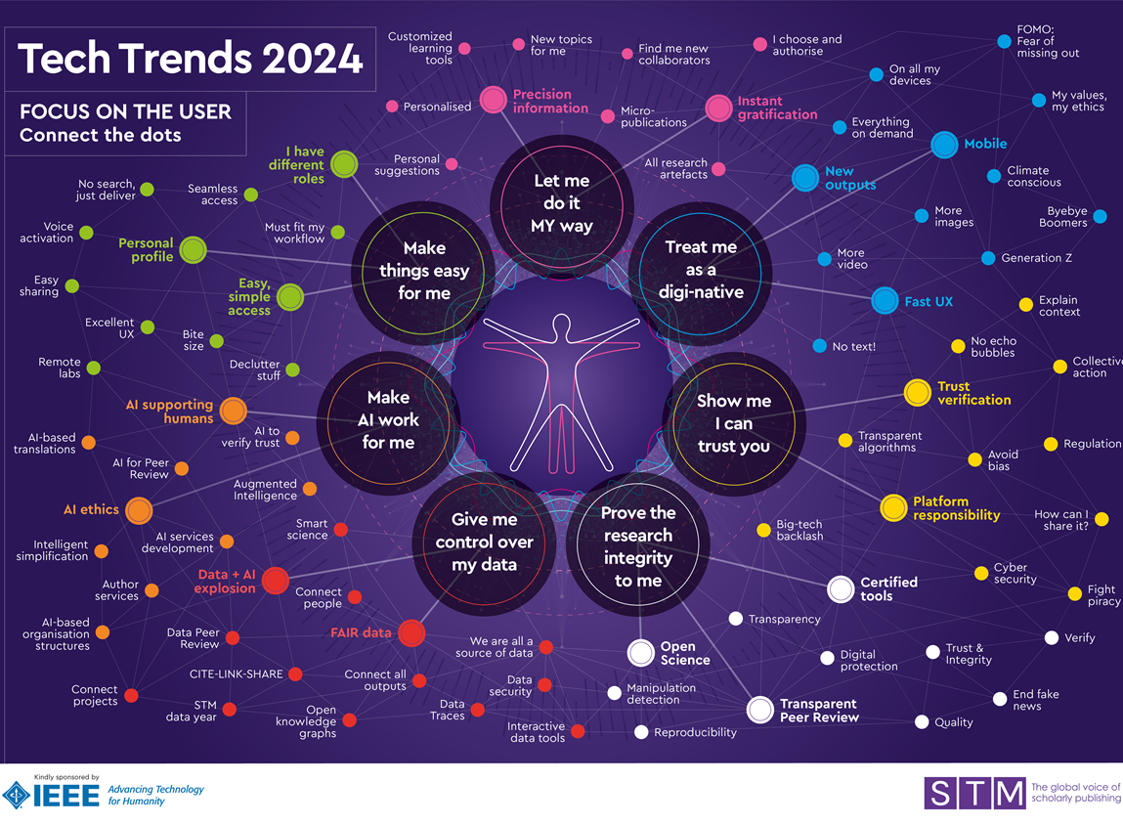

Slide 3
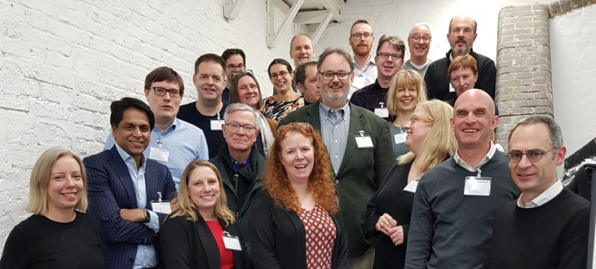
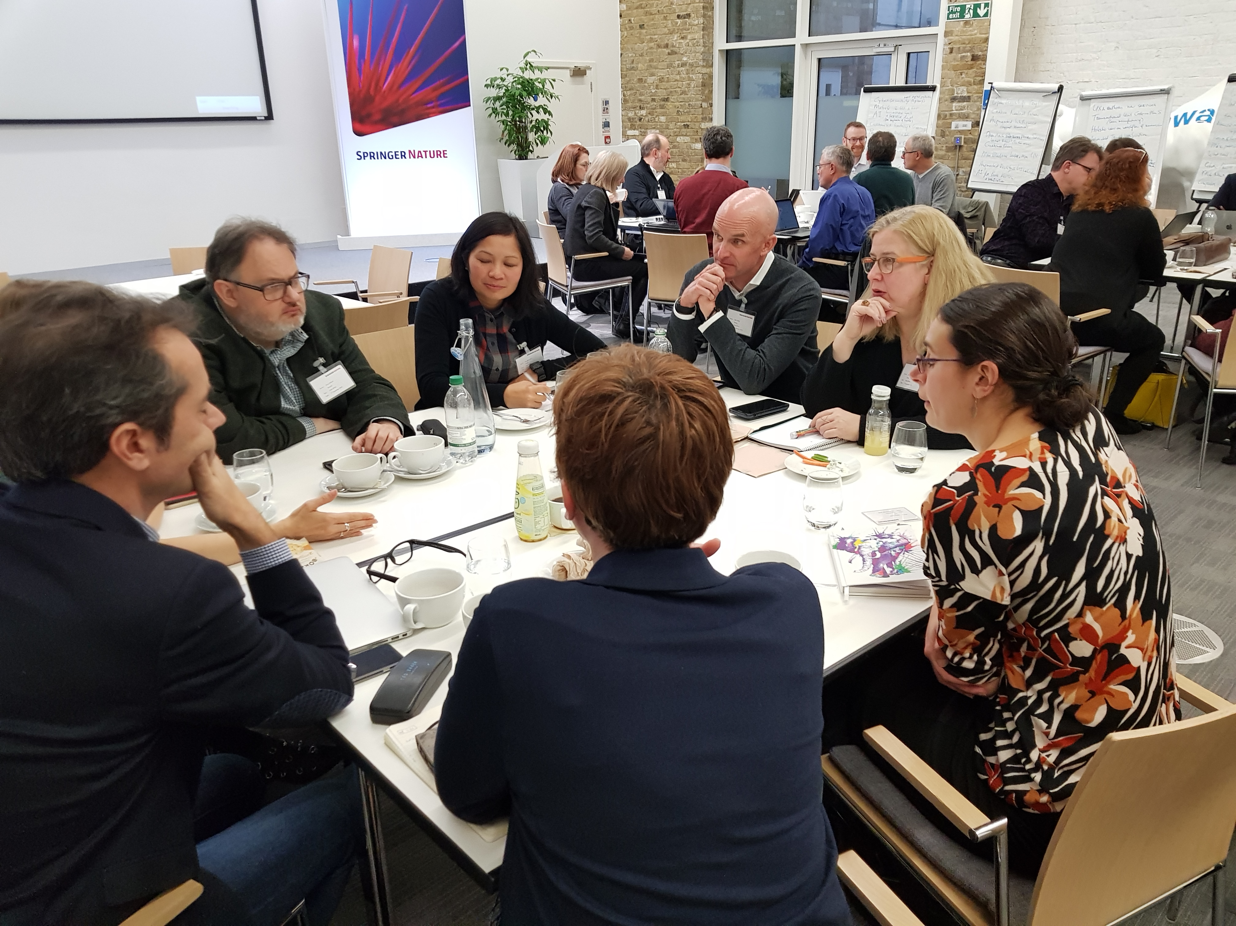
London, December 2019:
Collaboration at work!
STM Future Lab Brainstorm Meeting at The Stables
Using the Delphi Method for Technology Forecasting
This year: 28 participants from STM member organisations
Mostly senior staff in: Innovations, Technology,
Strategy, Business development, Platforms, IT
  Editing Committee:
  IJsbrand Jan Aalbersberg (ELS)
  Heather Staines (Knowledge Futures)
  Reynold Guida (IEEE)
  Kent Anderson (Caldera)
  Debbie Sweet (Cell Press)
  Liz Marchant (Taylor & Francis)
  Sameer Sharif (Impelsys)
  Eefke Smit (STM, Editor)
  Matt McKay (STM, infograph)
Sponsors: IEEE, SpringerNature

Slide 4
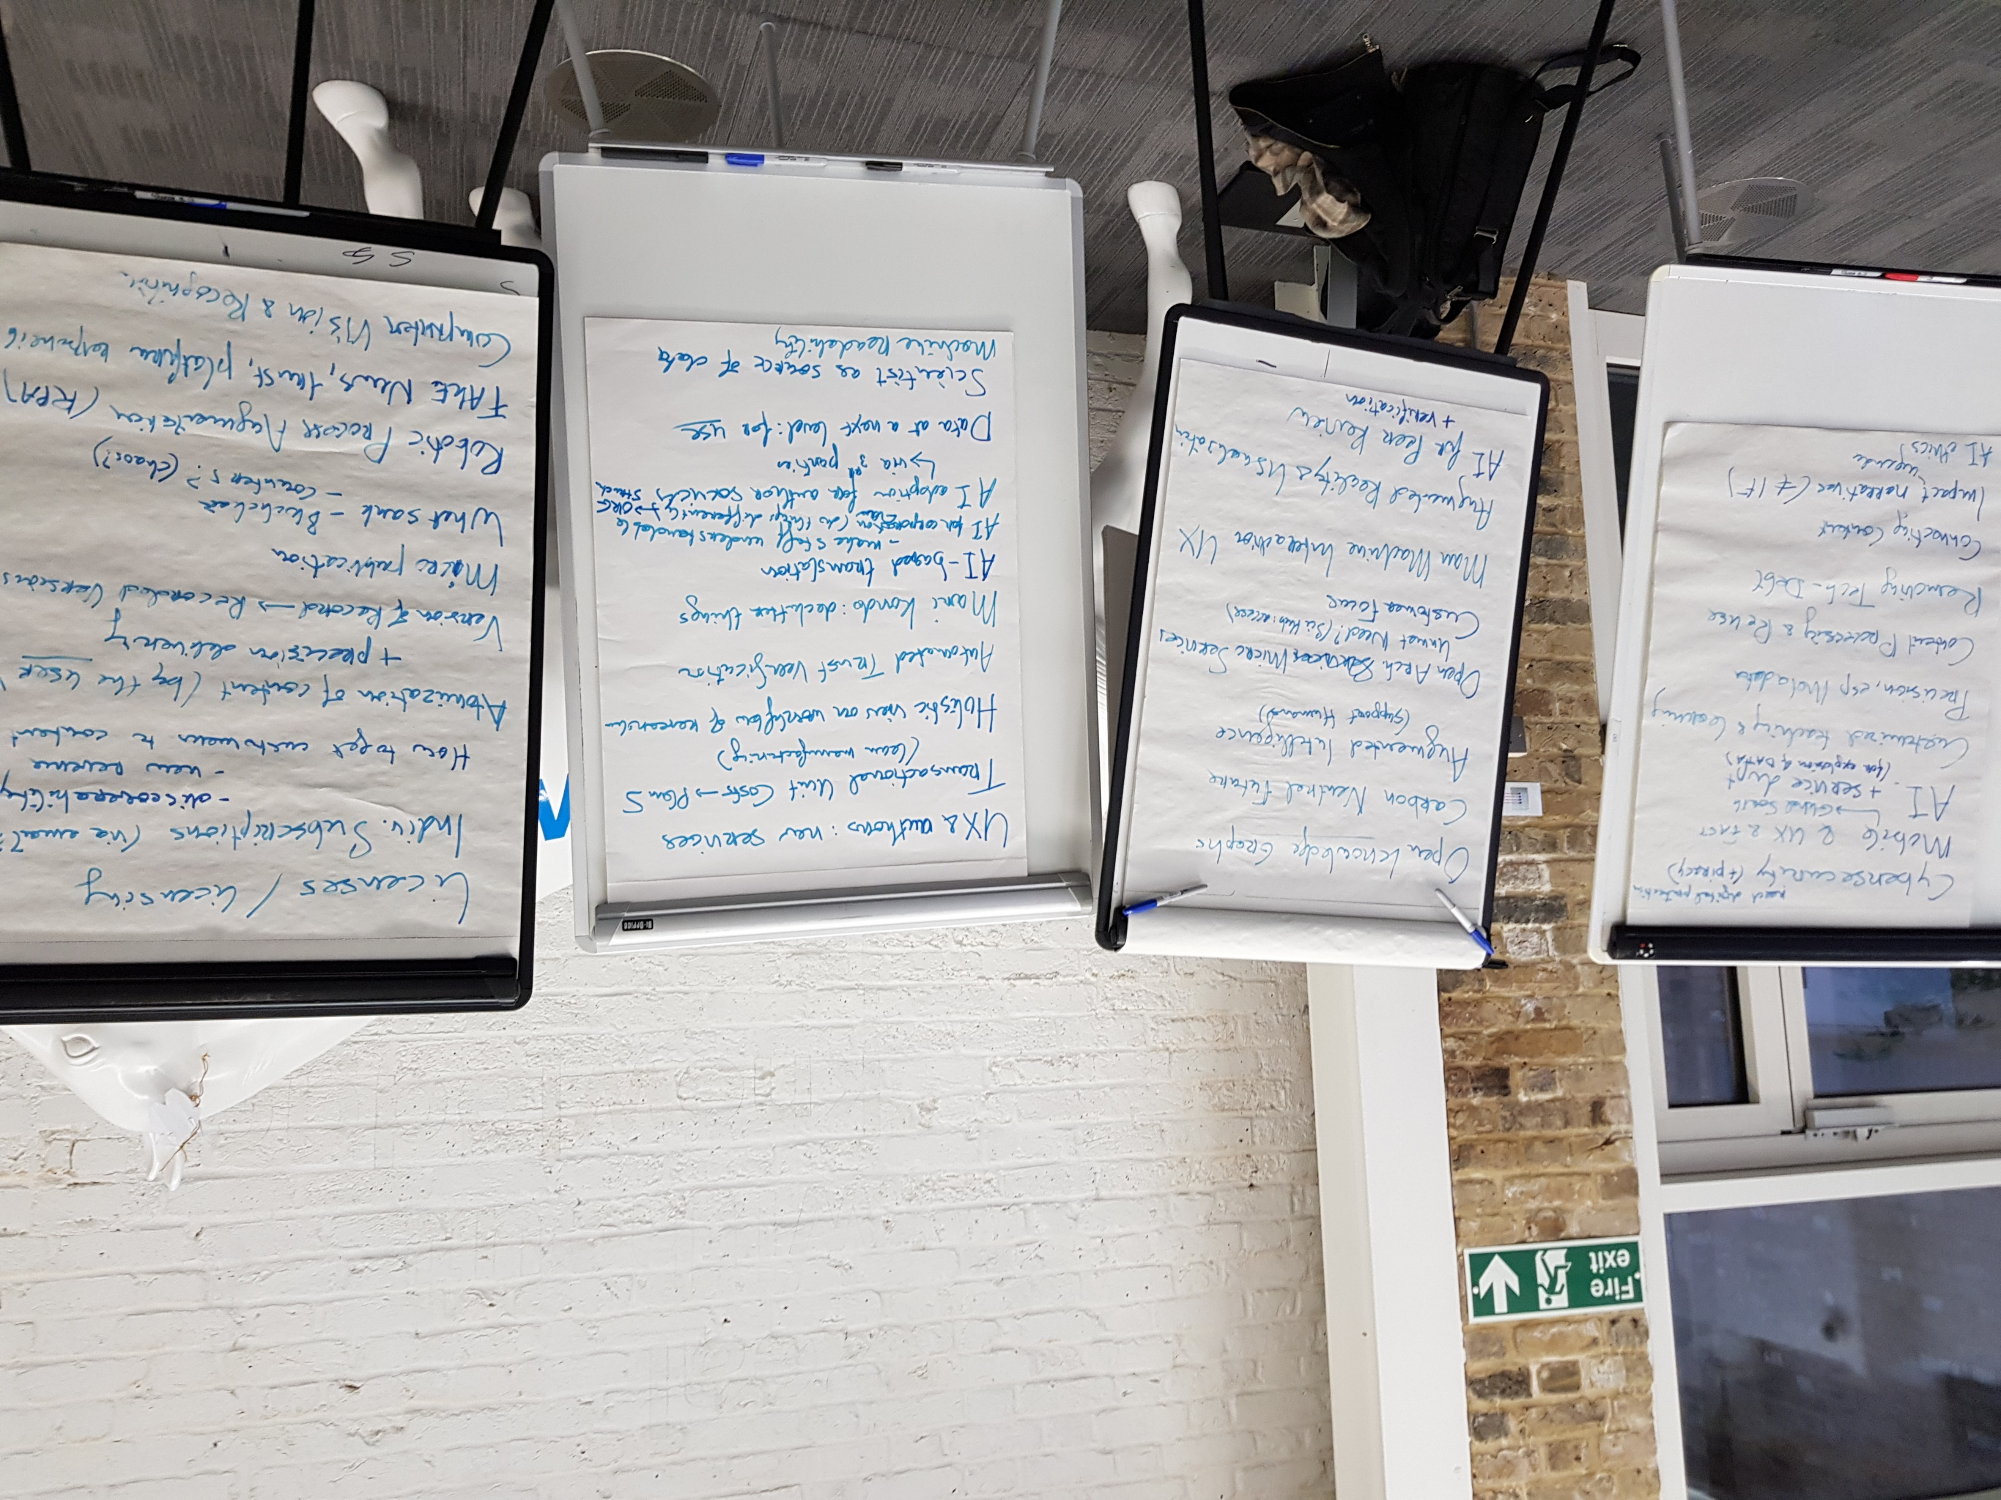

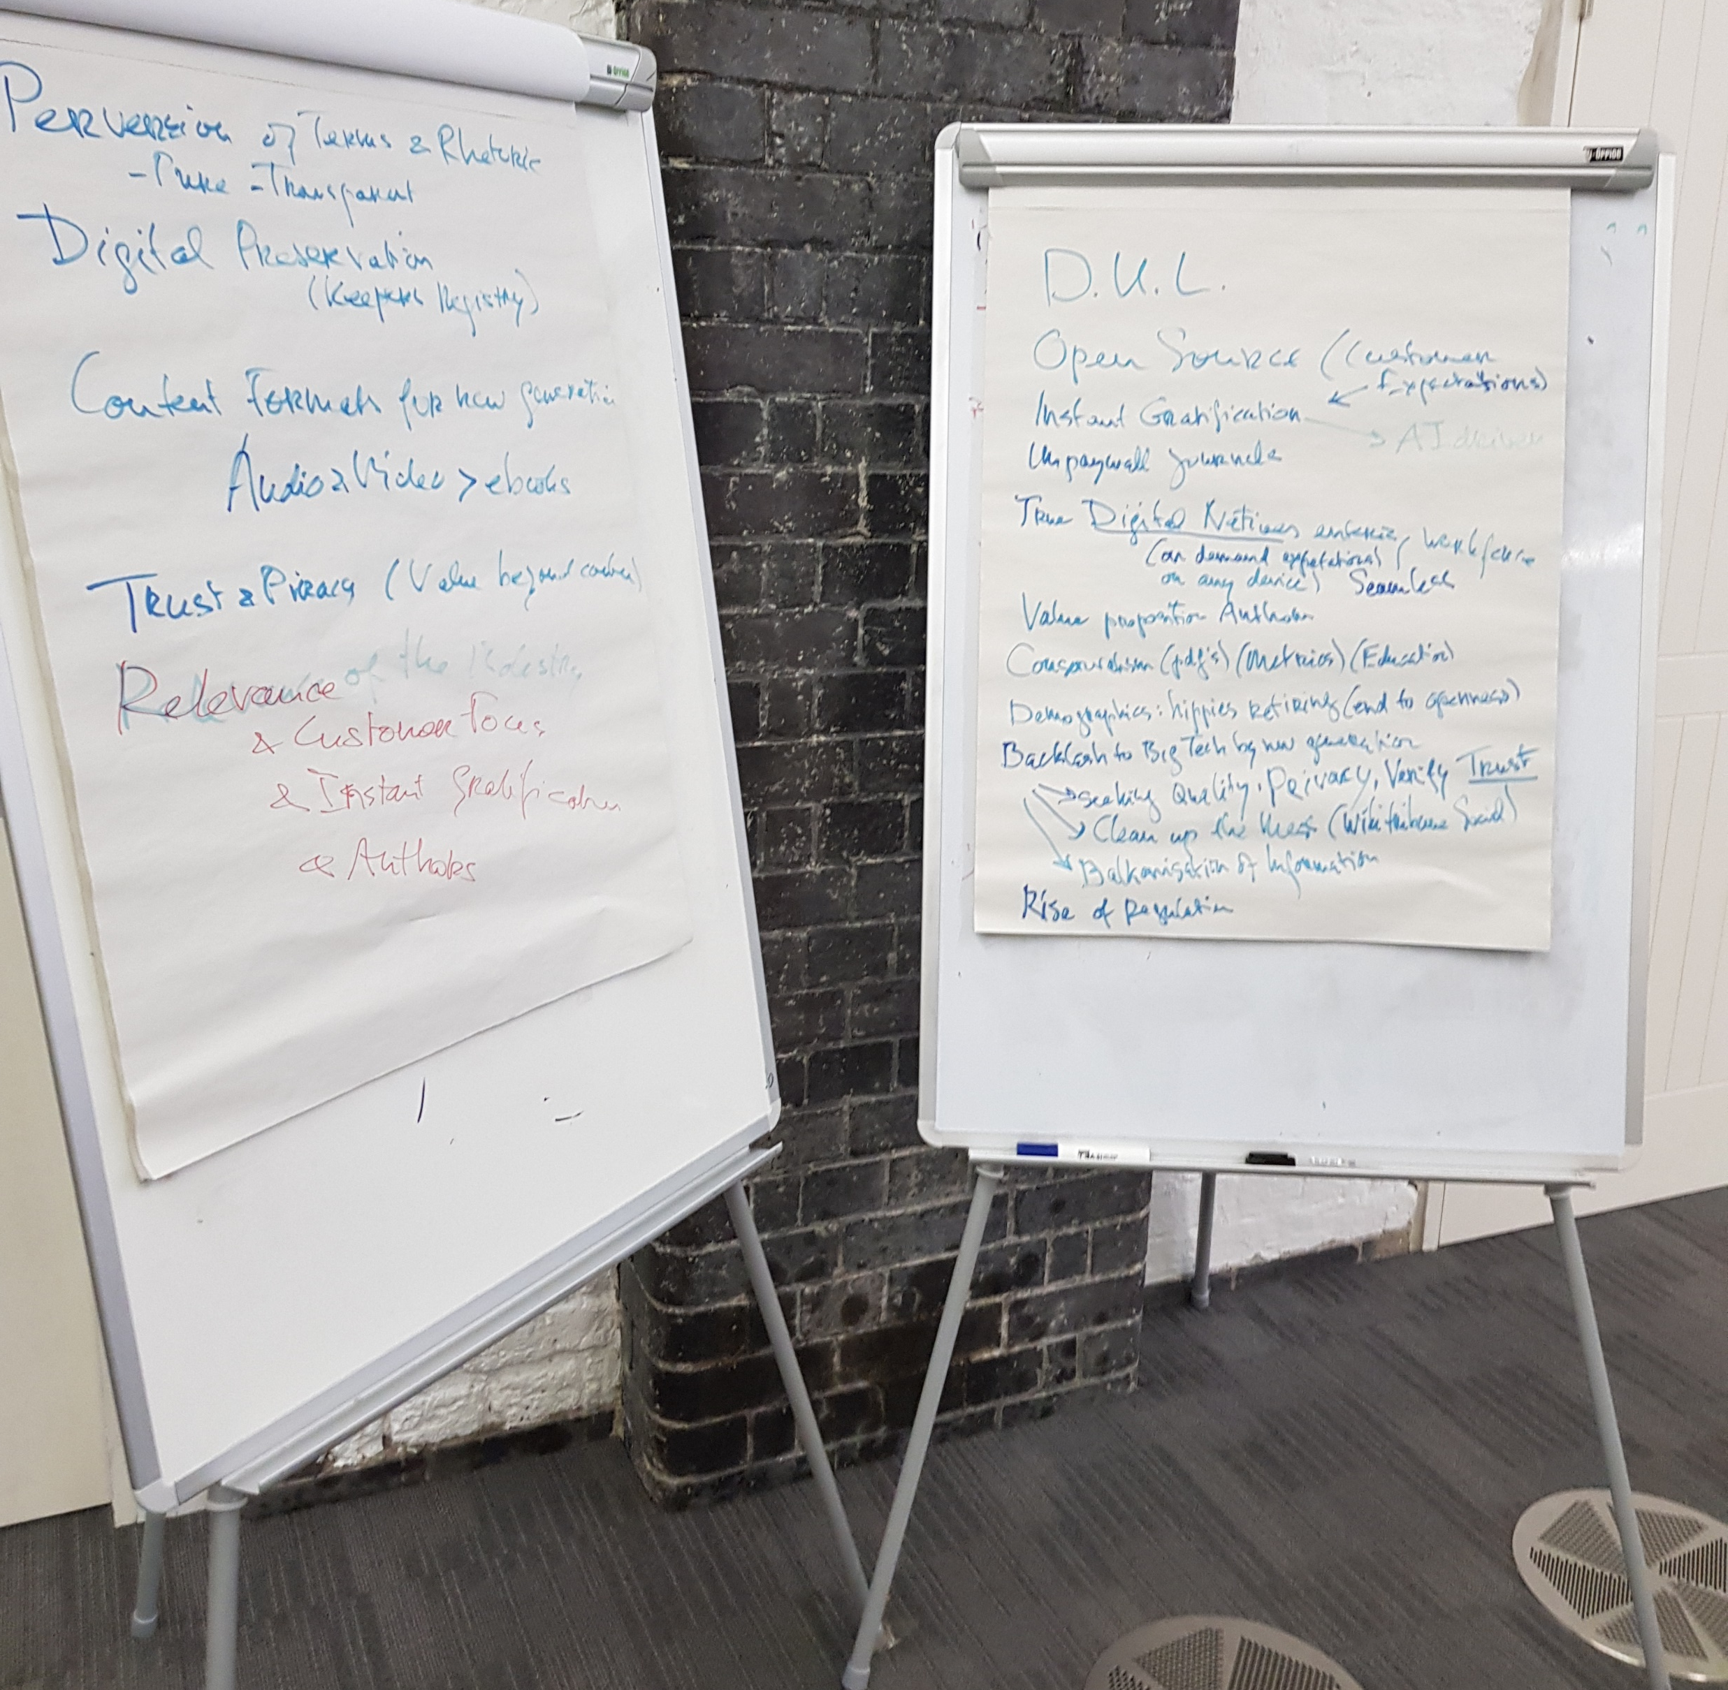
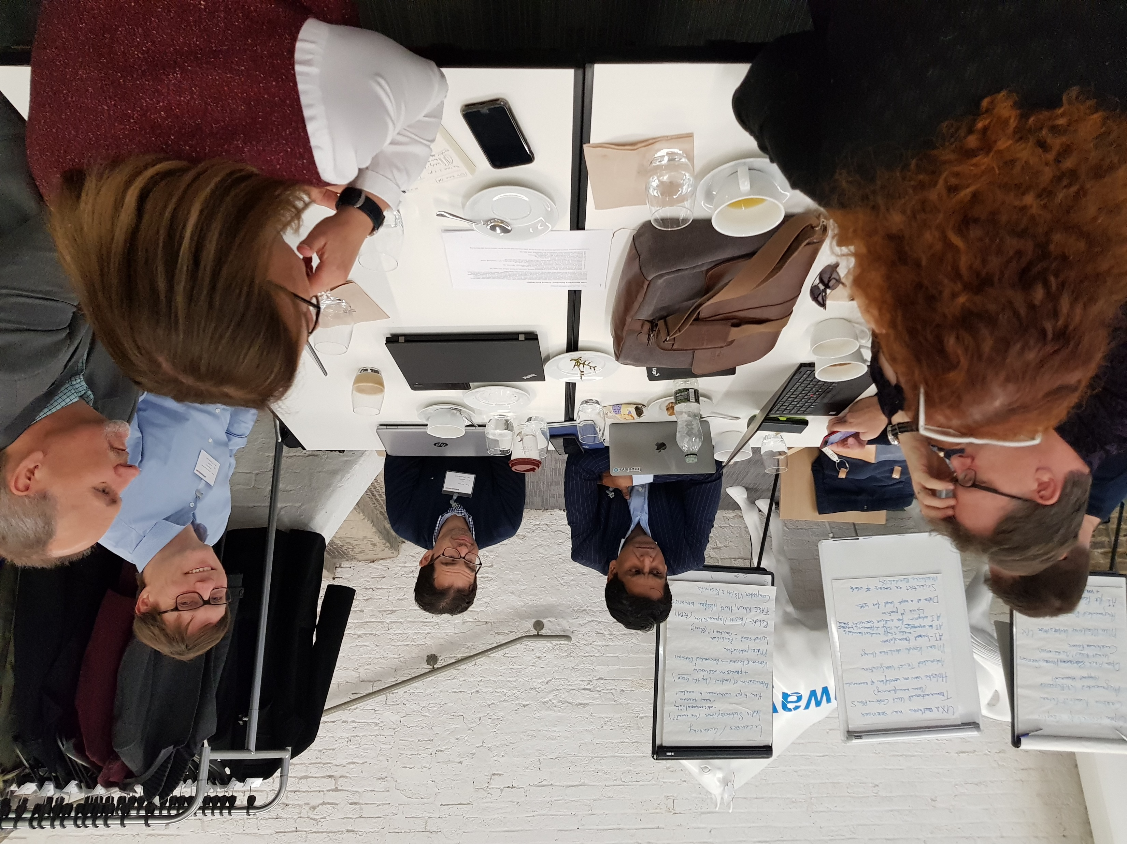
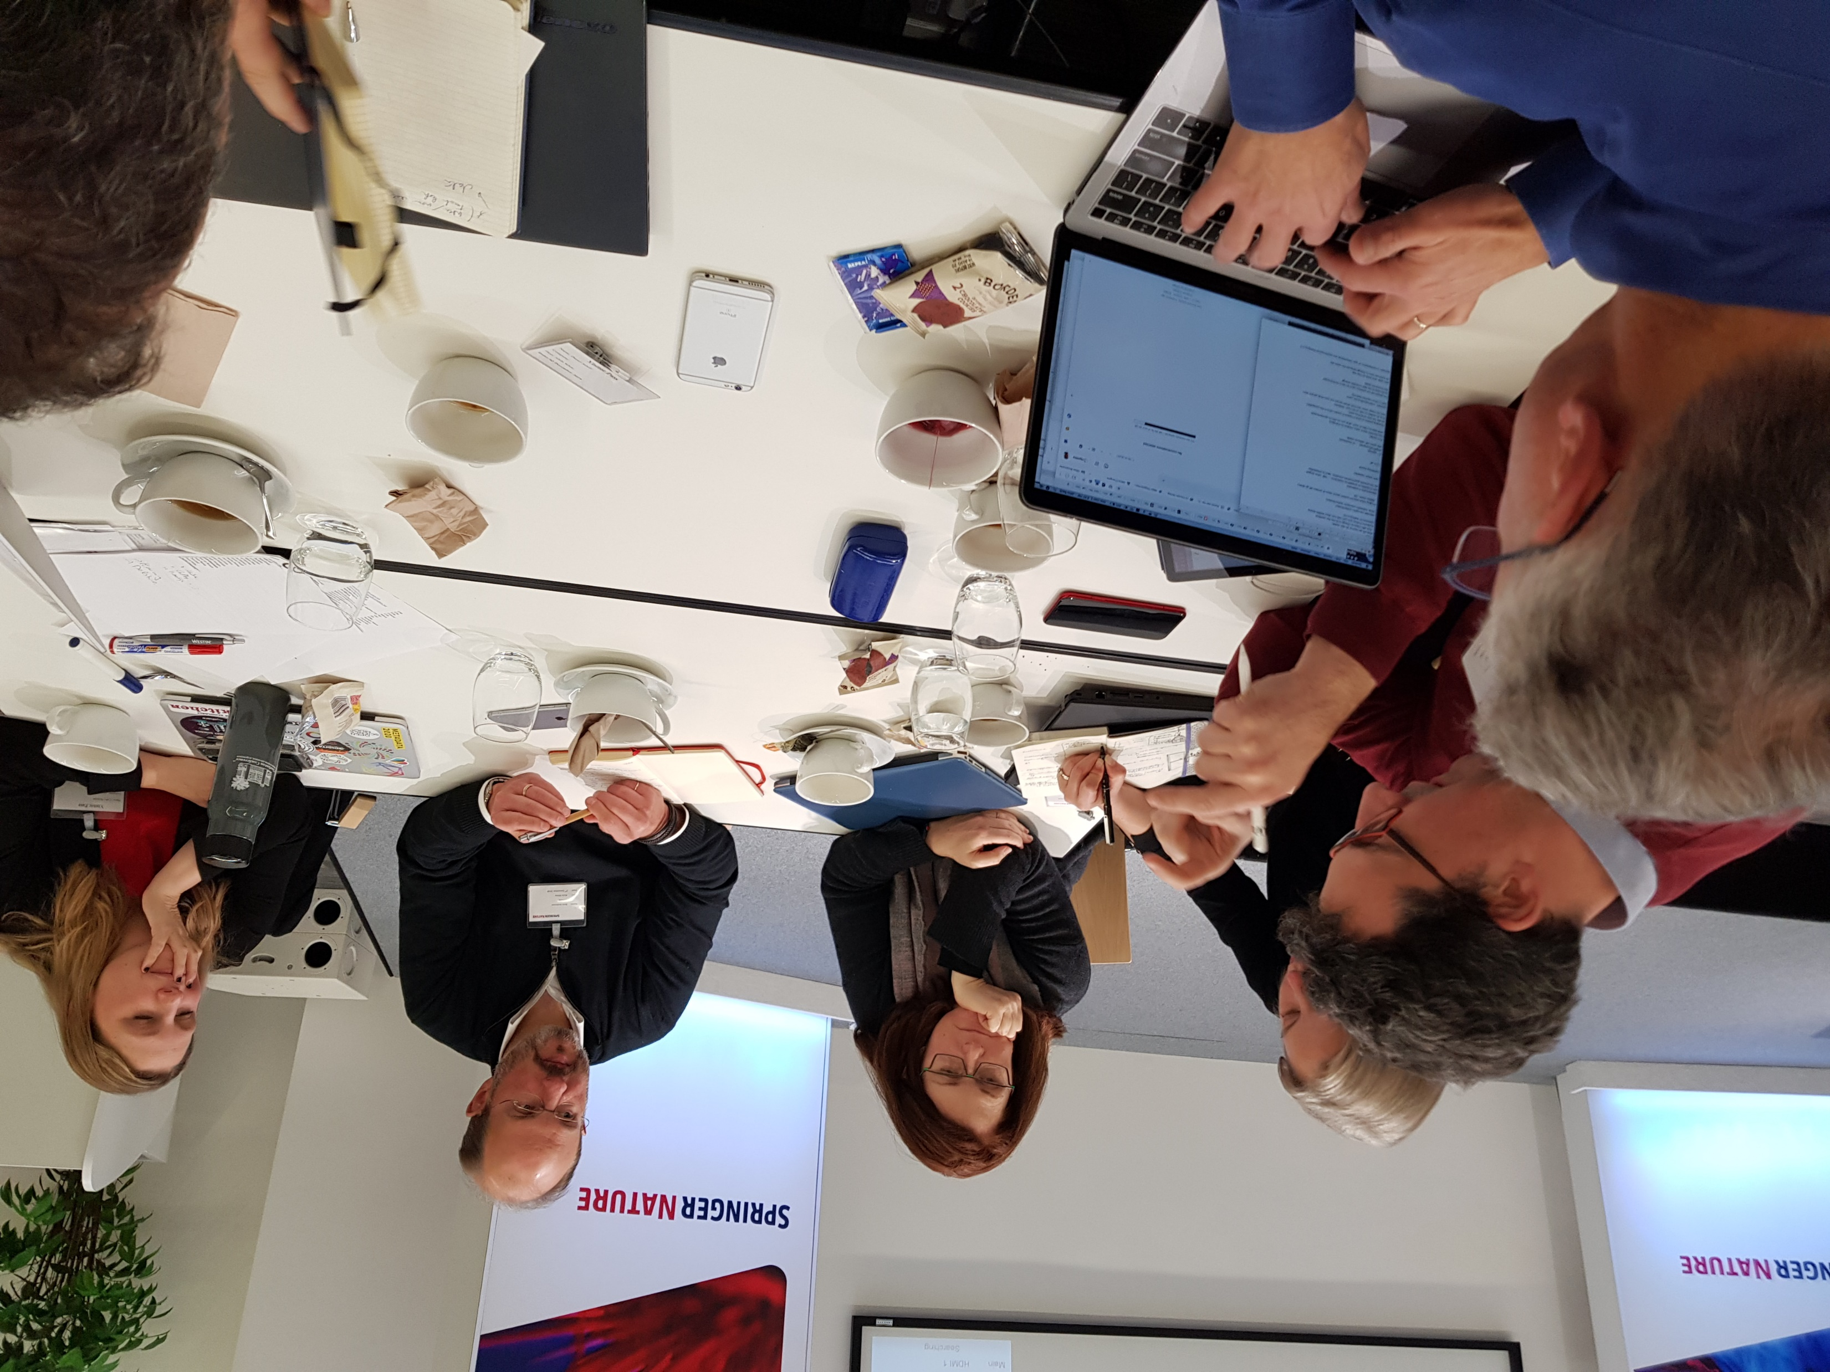
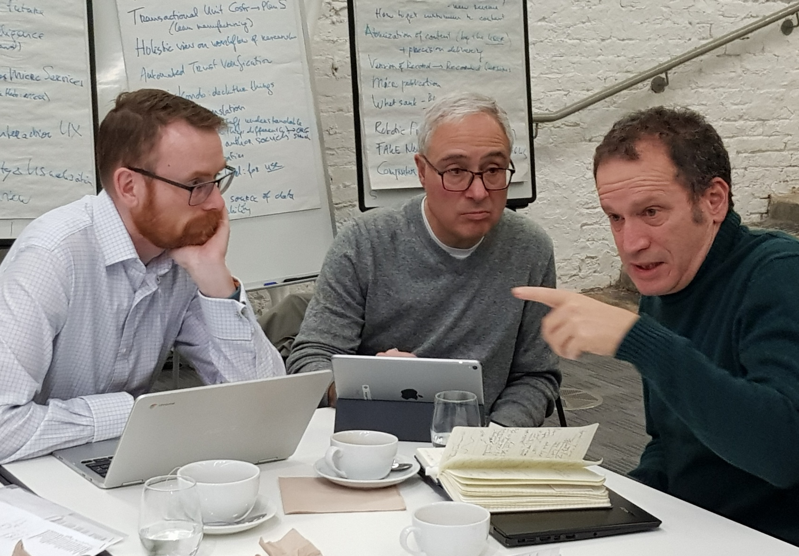
creating……….a room full of views
Using the Delphi Method….

Slide 5
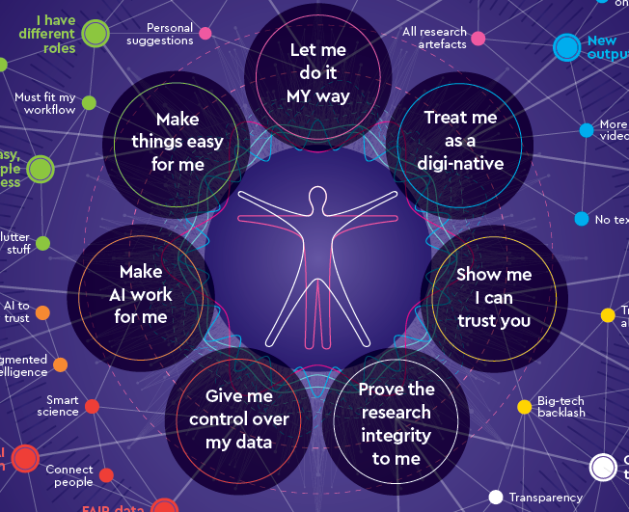

Slide 6
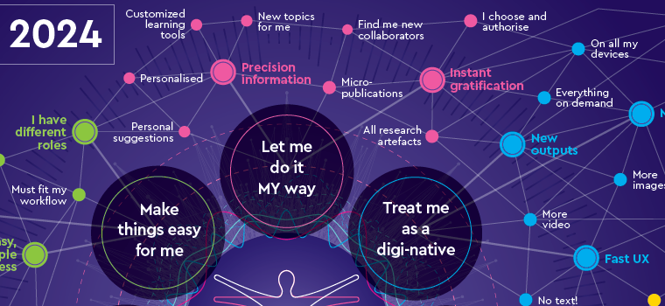

Slide 7
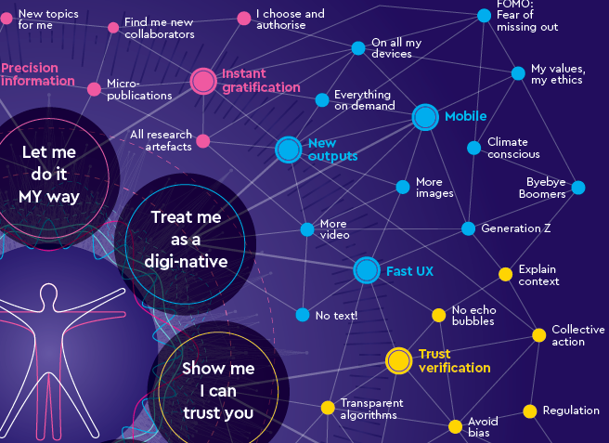

Slide 8
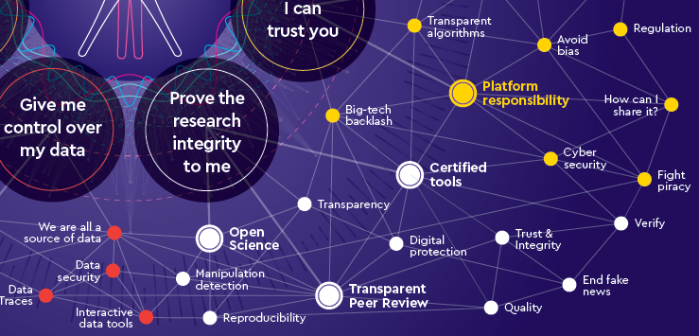

Slide 9
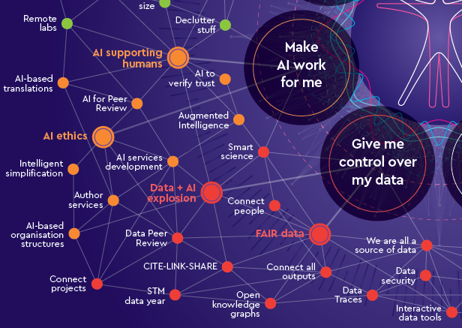

Slide 10
