Slide 1

STM Mentoring Programme 2017
Mentor Presentation
Monday 10th April, 2017
Notes:
RM

Slide 2
Introductions
Rachel Moriarty – Computer Science Editor at Springer Nature
Jason Mitchell – Publishing Services Manager at Elsevier
Mandeep Kundi – Learning and Development Manager at BMJ
Notes:
RM
My name is Jason Mitchell, and I am PSM at Elsevier Content Reference and I have been involved with STM since 2014.

Slide 3

Agenda
Objectives of the STM Mentoring Program
What is mentoring?
Qualities of Good Mentors
How does it work?
How to establish a good mentoring relationship
Reverse Mentoring
Outcomes for successful mentoring partnerships
Next Steps
Support and Useful Links
Questions & Answers
Notes:
RM

Slide 4
Overall Objectives of the STM Mentoring Program
To articulate the benefits of Mentoring to the wider Publishing Industry
To facilitate the creation of successful relationships between Mentors and Mentees
To provide guidance and support that ensures Mentors and Mentees benefit from the process
To evaluate the effectiveness of the Scheme and identify refinement for future delivery
Notes:
MK

Slide 5
What is mentoring and how is it different to coaching?
Mentoring
Guiding and assisting by giving advice based on the mentors' experience
Usually provided by someone more senior who knows the organisation/role
A more informal approach
Objectives and outcomes desirable but not essential
Coaching
Helping someone to find solutions through the 'coachee's' own experiences
Advice is not given but problems are solved by the 'coachee'
A structured approach with defined outcomes
Notes:
MK

Slide 6
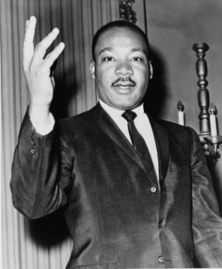
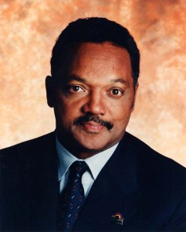
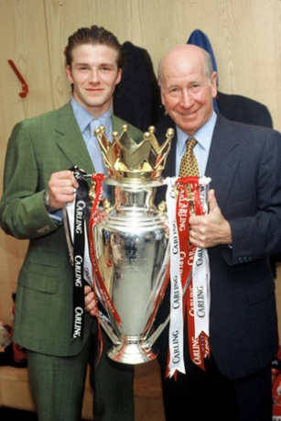
The qualities of a good mentor
Fully committed to mentoring
Approachable and positive
Non-judgemental
Supportive - offers to review work, suggests useful contacts
Constructive - suggests things that may have helped in the past
Willing to learn – reverse mentoring
Dr Martin Luther King
& Jesse Jackson
Sir Bobby Charlton
& David Beckham
Notes:
MK

Slide 7
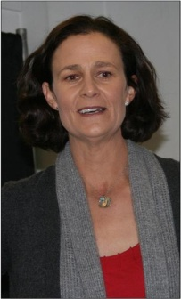


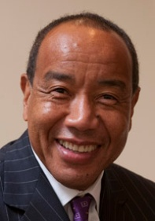
The skills of a good mentor
Relationship building & Communication skills
  Inspires trust
  Good listening skills
  Asks questions and gives advice
  Story teller
  Good role model
  A good motivator
Broadening the horizon
  Encourages the mentee to bring topics to the table
  Facilitates focus on long-term professional development
  Explores wider range of alternatives with mentee to aid decision making
Pam Shriver & Venus Williams
Warren Buffet & Michael Lee-Chin
Notes:
MK

Slide 8
STM Mentoring programme
Mentors /Mentees register for mentoring
Panel selects and matches mentors with mentees
Mentor /Mentee are introduced and provided with support
Mentor /Mentee meetings commence
Evaluation: to ensure the programme is beneficial
How does it work?
Notes:
MK/JM So how does the STM mentoring scheme work? To start with, the committee prepared the ground for mentors and mentees to register their interest to take part. We had an excellent level of interest in the mentoring scheme, following on from the 2016 pilot scheme, with an even higher number of mentor and mentee applicants.
The committee then met on at least 3 occasions to look through the background, current roles, skillsets and mentoring goals from each registered application and carefully matched the mentees to that of the mentors. I think it’s fair to say that this is the most detailed part of the process, with the committee taking the most care and attention to it in terms of doing our utmost to get the matching right, so that not only do they complement each other as much as possible there is also the possibility of the mentor being the right person to confidently communicate and potentially stretch their mentee.

Slide 9
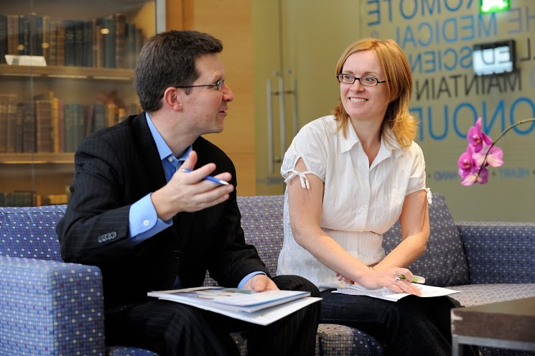
How to establish a working contract and ground rules?
First meeting - objectives
Establish what it isn't about
Identify broad topics not specific outcomes
Setting expectations
Template document to assist first steps
Confidentiality and boundaries
Conflicts of interest
Meeting format, location, timing and frequency
We suggest you allow 2 hours for your first meeting and 1 hour per session thereafter
Notes:
JM Establishing the ground rules for your mentoring relationship is really important and we would recommend that this forms the basis of your first meeting or call with the mentee.
It’s best to have the Mentee go over the basics at this point. What are their objectives and why? What do they want to achieve and by the end of it, what knowledge or skillset do they want to have accomplished? It would be good to get the mentee to talk through their stated goals and ask questions around that.
Establlsh what this isn’t about. So you as Mentors are not expected to be on call 24/7 over the next 6 months. Neither are you expected to solve all of their problems. The mentoring relationship is instead about regular, perhaps monthly pre-arranged meetings to guide the mentee on the path towards achieving their own goals through their own efforts. The onus is on them.
It would be good to talk about broad topics at this point, so touch upon key themes or topics but at this stage not in any great detail. That will happen as you go along and develop more contact and understanding of each other.
Setting expectations: So, as mentioned, this first meeting will confirm the mentee’s initial development objectives and immediate goal(s), agree mutual expectations and help clarify both parties’ roles from the outset; covering issues of confidentiality, boundaries, style of mentoring, and how/when you decide to contact each other outside of arranged meetings.
Confidentiality is of course a prerequisite on both sides. You may become privy to activities going on within other STM organisations, they may be your competitor, but we ask that you retain that information only for the purposes of aiding your mentee. Trust is a vital component of the mentoring relationship.

Slide 10

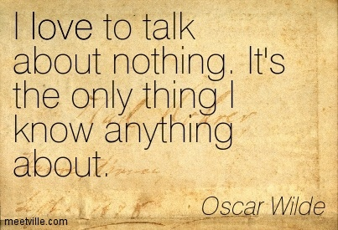

Common pitfalls
Mentoring process:
Not knowing what to talk about or talking too much!
No defined end point/periodic review
Irregular and postponed meetings
Confusion of roles
Breach of contract/ground rules:
Being indiscreet
Not questioning: is it working?
Avoiding terminating the relationship, should it become toxic
Mentoring context:
Cultural differences
Virtual mentoring: finding the right technology
Notes:
JM It is rare but mentoring relationships do not always work out as intended. It’s worth recognising that not every mentorship will work out, for all of these reasons, and it may well be fairer to recognise that it is going awry, and why that is, and if necessary bringing it to an end. Of course we hope this does not happen, and we on the STM committee would like to be informed and make efforts to rectify the situation, but will of course respect the feelings of both parties if this arises.

Slide 11

Reverse Mentoring
Notes:
MK

Slide 12
Outcomes for successful mentoring partnerships
For Mentors
Gain insights from mentee’s background
Gains satisfaction in sharing expertise with others
Re-energizes their own career
Learns more about other areas of the organisation and industry
Notes:
JM Increased satisfaction and motivation from ‘giving back’ to the industry and helping others to achieve their professional goals.
Development of leadership, management, coaching and listening skills.
Learning from the insights, ideas and different perspectives provided by mentees.
Feeling valued from being able to share knowledge and experience.
Increased recognition at both personal and corporate levels within the STM publishing industry.

Slide 13
Outcomes for successful mentoring partnerships
For Mentors and Mentees
Enhances professional development
Gain from exposure to other organisational cultures
Creating a mentoring culture promotes individual employee growth and development
Breaks down the "silo" mentality
Elevates knowledge transfer
Enhances strategic business initiatives
Encourages staff retention and reduces turnover costs
Notes:
JM

Slide 14
Personal Effectiveness through Mentoring – Action!
Step 1 = explore and discover more
Step 2 – Learn how to recognise and appreciate differences
Step 3 – Learn how to adapt and interact more effectively
Step 4 Take action and put your learning into practice
Notes:
MK

Slide 15
What happens next?
Arrange first meeting, if you have not already done so
Review Learning Style Questionnaire and support Mentee with outcome
Let your teams/Line Manager know you are involved in the program
Source resources and handy hints to help you
Agree desired objectives and outcomes with Mentee, along with a provisional timeline for relationship (suggestion: 10 to 12 months)
Contact the STM Mentoring Team if you have any questions!
Notes:
RM

Slide 16
Comments from past participants
Prepare for Meeting
“My advice for the next class of mentors would be to have some guidelines or sample topics/conversations prepared”
“We chat once a month on topics that he brings to the table and emails me in advance of meetings”
Agree Meeting Structure
“My mentor and I got along really, really well, but without a formal structure in place and with both of us being very busy, it just didn’t take off”
Review
“I wouldn’t have minded a little bit of homework either to encourage reflection on what my objectives were and how these were met throughout the relationship”
“I didn’t even realize that we are coming to a close in a few weeks; in other words, for me the mentee/mentor relationship is going well, but I had lost sight of the timeframe vis-à-vis the official program”
“Feedback on my coaching skills might be nice too – has it been worthwhile for my mentee?”
Enjoy the process!
“I love my mentees. Each of them is great in her own way. I've learned things from all of them, and hopefully I've been helpful to them. I definitely want to keep in touch with them after the trial period ends”
“Thanks for having me as a part of the program! I’ve really enjoyed being a part of it.”
Notes:
JM

Slide 17

Support
Line managers need to be aware and supportive of the mentoring relationship
Line managers perform general check in on progress but do not go into the detail
Line managers should acknowledge that mentoring relationships are part of their team member's development
Your HR department may be able to support
Notes:
RM

Slide 18
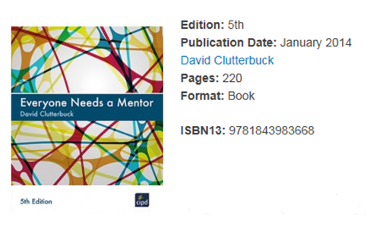
Contacts and Resources
STM Mentoring Committee - contact
Learning Styles Questionnaire - here
Mentoring Guidance Document – here
Book – Everyone Needs a Mentor, http://www.emccouncil.org/
Notes:
RM

Slide 19



Useful links
    https://twitter.com/stm_ecp
    https://www.linkedin.com/groups/8184238
https://www.facebook.com/STMECPC/
Notes:
RM/All

Slide 20
Questions?
Notes:
ALL

