Slide 1
Introducing SCHOLIX

Slide 2


The Data Publishing Services WG
Joint ICSU-WDS & RDA Working Group, focusing on linking up research data and the literature
Bringing together different stakeholders in the data publication landscape: data centers, publishers, institutional repositories, service & infrastructure providers, …
Data Literature Interlinking Service (with OpenAIRE & PANGAEA) including 1M+ links from various sources
SCHOLIX Guidelines

Slide 3
Linking Research Data and the Literature: why?
Linking Research Data with the Literature is of great value, yet current solutions are not realizing the potential
Why link?
Increase visibility & discoverability of research data (and articles)
Place research data in the right context to enable proper re-use.
Support credit attribution mechanisms
Examples
Some data repositories keep track of articles that cite, or refer to, their data
Some publishers have applications to link articles with data hosted externally
Providers of bibliographic information and infrastructure providers are taking efforts to “connect the dots”

Slide 4
So.. what’s the problem?
Linking Research Data with the Literature is of great value, yet current solutions are not realizing the potential
What is the problem?
Many disconnected sources (publishers, data centers, repositories, infrastructure providers, …)
Heterogeneity of practices, for example:
  Different PID systems (DOI, accession numbers)
  Different ways of referencing data (formal citations, in-text references, …)
  Different moments of citing data (at publication, post publication, …)
technical
social

Slide 5
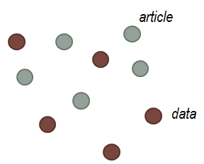
How? Well, it’s all about connecting the dots
Source 1
Source 2
Source 3
service

Slide 6
There’s several initiatives that are addressing (parts of) the problem, and in different ways…
DataCite-CrossRef eventdata:
DOI-DOI linking information exchange
Publisher – Data Center linking initiatives
(Mostly bilateral, no industry standards)
Data Citation Implementation Group:
Developing proper data citation technical standards
Better linking between Data and the Literature
Training, education, etc.
Data Citation Principles:
Guidelines to foster a culture of data citation

Slide 7

Introducing SCHOLIX: A framework for Scholarly Link Exchange
A new framework presenting a vision and guidelines for linking research data and literature using a common, global approach
An evolving lightweight set of Guidelines to increase interoperability rather than a normative standard.
The consensus achieved by the various stakeholder groups in the research data landscape – including data centers, publishers, Crossref, DataCite, OpenAIRE, and many others
See also http://www.scholix.org/about & http://bit.ly/29tdGNU

Slide 8
SCHOLIX Guidelines
Conceptual model
Information model
Options for exchange protocols
Information standards and encoding guidelines
See also http://www.scholix.org/about & http://bit.ly/29tdGNU

Slide 9
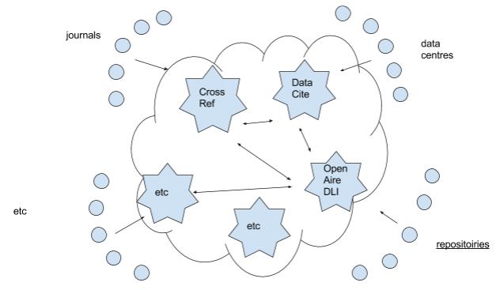
SCHOLIX: The Multi-Hub model

Slide 10
SCHOLIX in practice
Services that are (will be) utilizing the SCHOLIX interoperability framework:
Crossref Event Data and Linked Clinical Trials
DataCite Event Data
OpenAIRE and PANGAEA Data-Literature Interlinking (DLI) Service
More on that in the contributions by Geoff Bilder and Martin Fenner
How do we make this into a big success?
More on that in the last part of this session by Wouter Haak

