Slide 1



TDM in the Life Sciences
Application to Drug Repositioning *
Dr. George Tsatsaronis
Senior NLP Scientist, Operations (Content and Innovation)
e-mail: g.tsatsaronis@elsevier.com
* This research was conducted during the period 2010-2016, at the BIOTEC center, of TU Dresden, Dresden, Germany, and was funded by DFG, BMBF, and EU research projects/programs

Slide 2
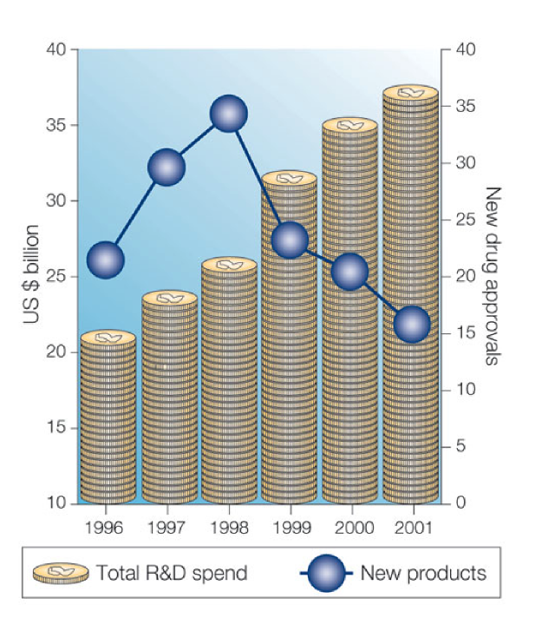
The Problem: Drug Repositioning
Dove, Nature, 2003
Costs for one drug: $500 million - $2,000 million
[Adams and Brantner, 2006]
2
  George Tsatsaronis, TDM in the Life Sciences, 16/11/2016, EC

Slide 3


The Potential: TDM in Life Sciences enables us to…
ask a question:
What is the biological role of expansins in fungi?
and get back an answer automatically:
Expansins are extracellular proteins that increase plant cell-wall extensibility. These wall-loosening proteins are involved in cell wall extension and polysacharide degradation. In fungi expansins and expansin-like proteins have been found to localize in the conidian cell wall and are probably involved in cell wall remodeling during germination.
3
  George Tsatsaronis, TDM in the Life Sciences, 16/11/2016, EC

Slide 4

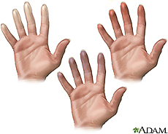

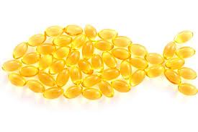
The Potential: TDM in Life Sciences enables us to…
focus on some specific disease:
Raynaud’s Syndrome
and get an automatically generated hypothesis on treatment options:
Fact 1: Tiejen 1975:
“patients with Raynaud’s syndrome… increased blood viscosity”
Fact 2: Woodcock 1984:
“Beneficial effect of fish oil on blood viscosity”
Hypothesis: Fact 1 + Fact 2: Fish oil as treatment of Raynaud’s syndrome
4
  George Tsatsaronis, TDM in the Life Sciences, 16/11/2016, EC

Slide 5


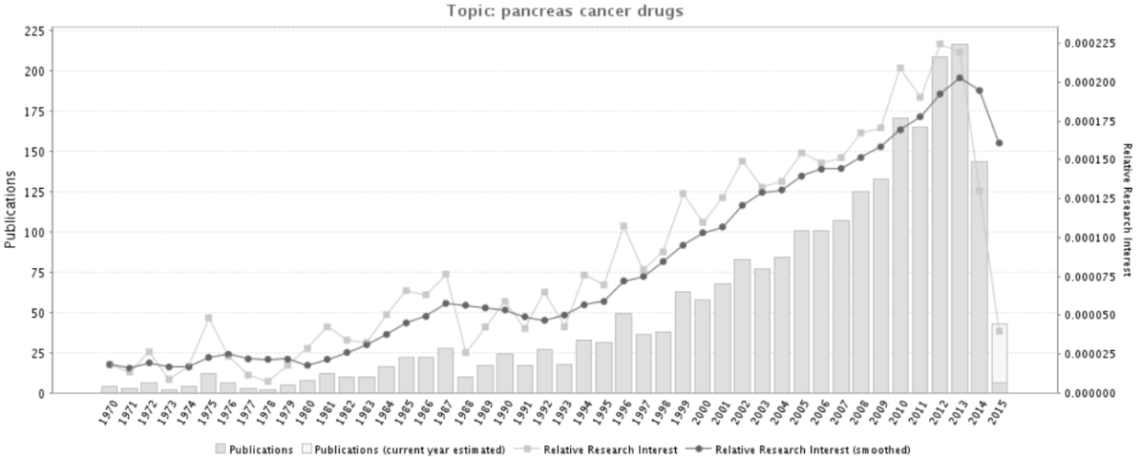
The Potential: TDM in Life Sciences enables us to…
focus on a scientific field:
and get automatically a view on where is research going:
5
  George Tsatsaronis, TDM in the Life Sciences, 16/11/2016, EC

Slide 6





The Current State Of the Art
…these case studies can already be reproduced by existing text mining engines, e.g.,
using text and data mining, natural language processing and semantic integration of resources.
6
  George Tsatsaronis, TDM in the Life Sciences, 16/11/2016, EC

Slide 7
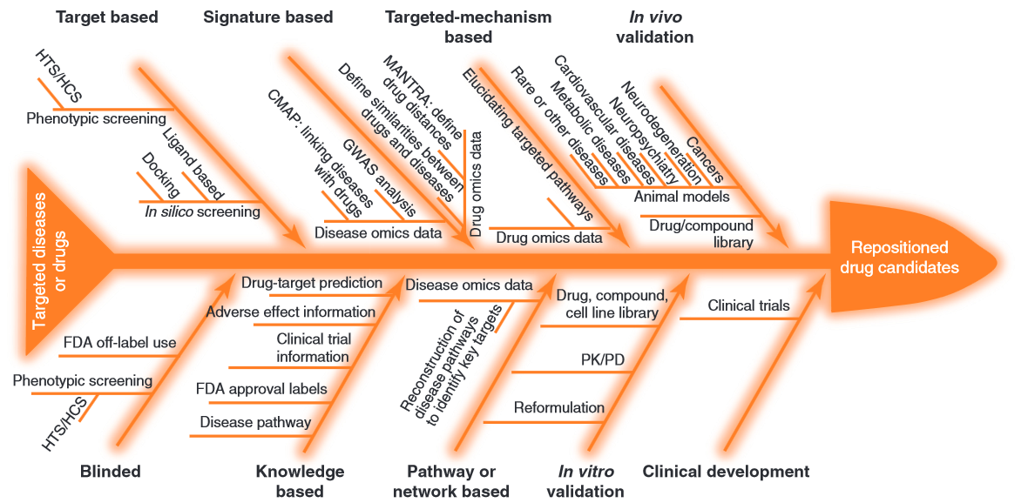
The Process: An Overview
7
  George Tsatsaronis, TDM in the Life Sciences, 16/11/2016, EC

Slide 8
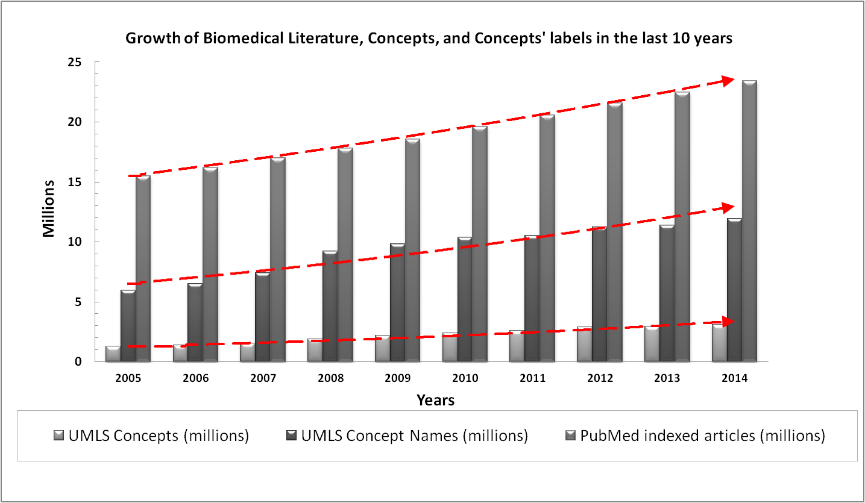
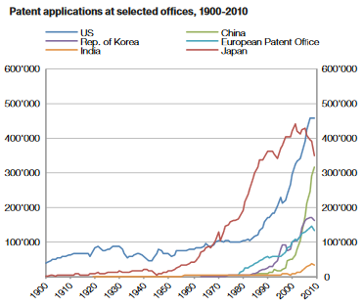
The Challenges: Scalability and Multilinguality
Source: World Intellectual Property Report 2011, WIPO
http://www.wipo.int/edocs/pubdocs/en/intproperty/944/wipo_pub_944_2011.pdf (pp. 52-53)
8
  George Tsatsaronis, TDM in the Life Sciences, 16/11/2016, EC

Slide 9
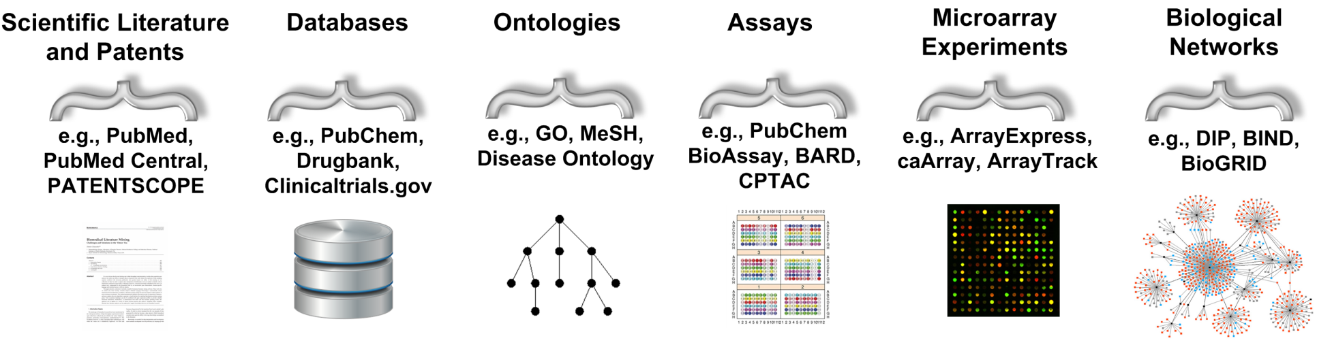
The Challenges: Heterogeneity and Integration of Resources
During the 6 years of research in TU Dresden, we never had problems accessing the data; the main challenges have been how to integrate and combine all of this information, find the human expertise to guide the TDM feature engineering process, and create models with a biological basis/interpretation that is reasonable.
9
  George Tsatsaronis, TDM in the Life Sciences, 16/11/2016, EC

Slide 10
The Algorithm
Annotate all of the textual resources (e.g., clinical trials, patents, database entries, ontology definitions, scientific abstracts, gene functions) with ontological concepts
Unify/integrate the annotated information
Focus on Drugs, Targets (Genes and their products), Diseases
Use statistical measures such as PMI and chi-square to build entities’ profiles keeping the most important terms that describe each drug and each gene (alternatively, word vectors, deep learning, recurrent neural nets with skip-grams)
Use measures of semantic relatedness to compute the pairwise similarity of drug and gene profiles
Rank the most associated genes for each drug
Verbalize the connections/relations
Allow expert biologists/clinical doctors to review and reject obvious false positives
Manually/Automatically collect supporting evidence for the remaining top-ranked pairs; Suggest Drug repositioning of that drug via this target (gene) for the indications participating in the profiles
10
  George Tsatsaronis, TDM in the Life Sciences, 16/11/2016, EC

Slide 11
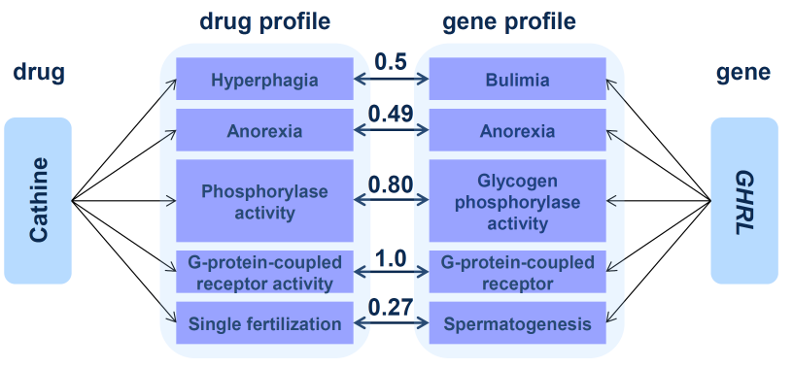
The Results
M. Kissa, G. Tsatsaronis, M. Schroeder. “Prediction of drug-gene associations via ontological profile similarity with application to drug repositioning”, Elsevier Methods, In Press, 2015
11
  George Tsatsaronis, TDM in the Life Sciences, 16/11/2016, EC

Slide 12
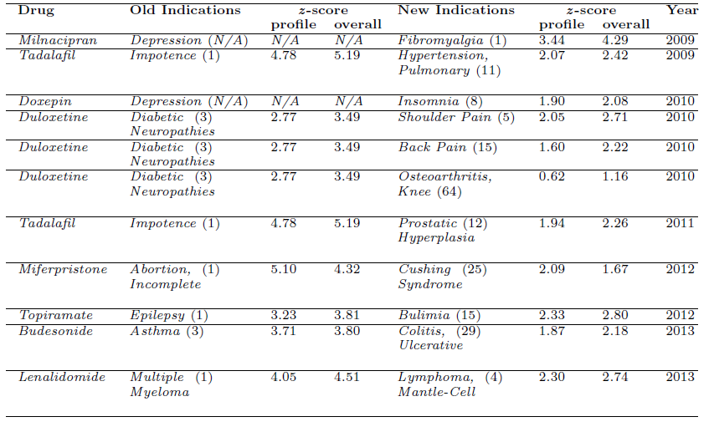
The Potential
M. Kissa, G. Tsatsaronis, M. Schroeder. “Prediction of drug-gene associations via ontological profile similarity with application to drug repositioning”, Elsevier Methods, In Press, 2015
12
  George Tsatsaronis, TDM in the Life Sciences, 16/11/2016, EC

Slide 13
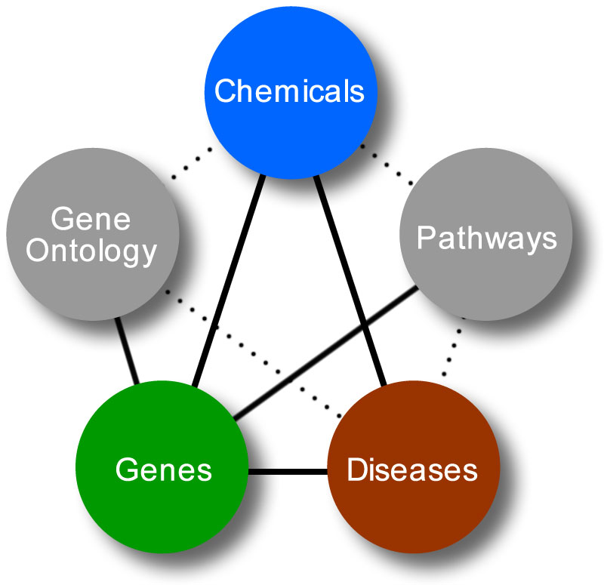
The Main Bottleneck: Open Challenges
Verbalizing datasets (assays, microarray experiments) and ontologies and integrate them
Create models that produce results with biological interpretations
13
  George Tsatsaronis, TDM in the Life Sciences, 16/11/2016, EC

Slide 14
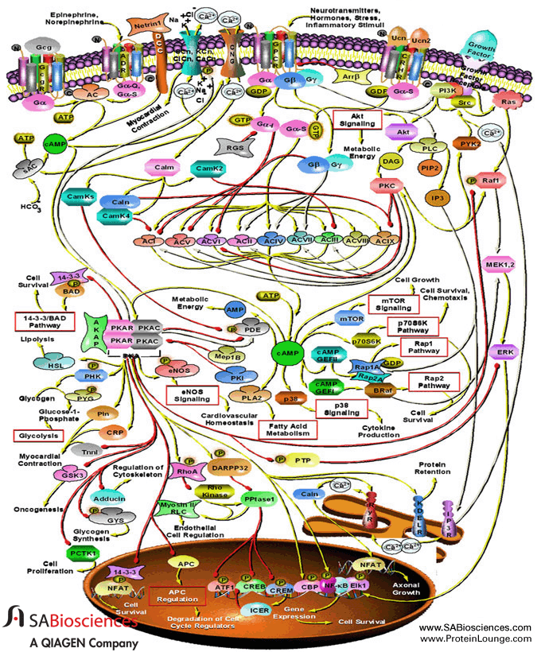
The Main Bottleneck: Complexity
14
  George Tsatsaronis, TDM in the Life Sciences, 16/11/2016, EC

Slide 15
Conclusions and Take Home Messages
Semantic integration and data/text mining already provide helpful novel tools and services to researchers.
We are experiencing the transition to the era of automated hypothesis generation and validation!
Key challenges are:
  Integration of the heterogeneous data sources
  Interpretation of models and predictions
  Human expertise on how to link resources, and what features to use for the model learning
15
  George Tsatsaronis, TDM in the Life Sciences, 16/11/2016, EC

Slide 16

Thank you very much for your attention!
Questions / Discussion
16
  George Tsatsaronis, TDM in the Life Sciences, 16/11/2016, EC

Slide 17

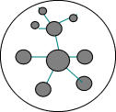
Can we exploit all this information? The life circle of TDM
Unstructured Text
(implicit knowledge)
Information
Retrieval
Information
extraction
Knowledge
Discovery
Semantic metadata
Structured content
(explicit knowledge)
Semantic
Search/
Data Mining
17
  George Tsatsaronis, TDM in the Life Sciences, 03/11/2016, EC

Slide 18
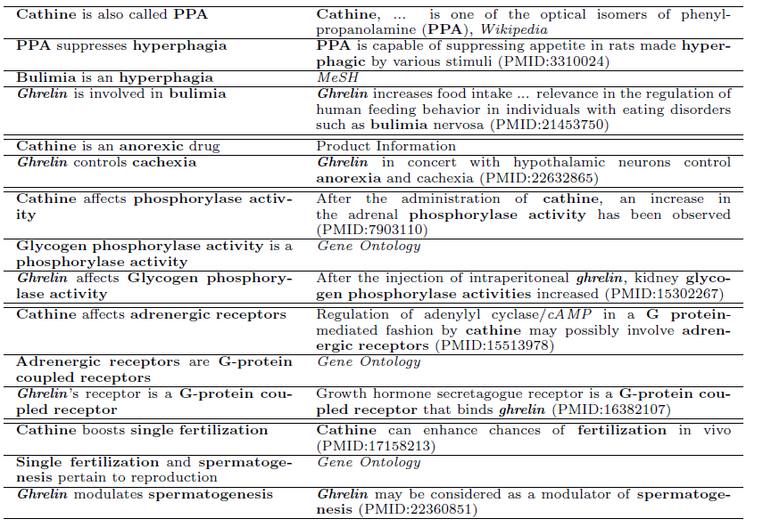
Application: Drug Repositioning; evidence
M. Kissa, G. Tsatsaronis, M. Schroeder. “Prediction of drug-gene associations via ontological profile similarity with application to drug repositioning”, Elsevier Methods, In Press, 2015
18
  George Tsatsaronis, TDM in the Life Sciences, 03/11/2016, EC

Slide 19
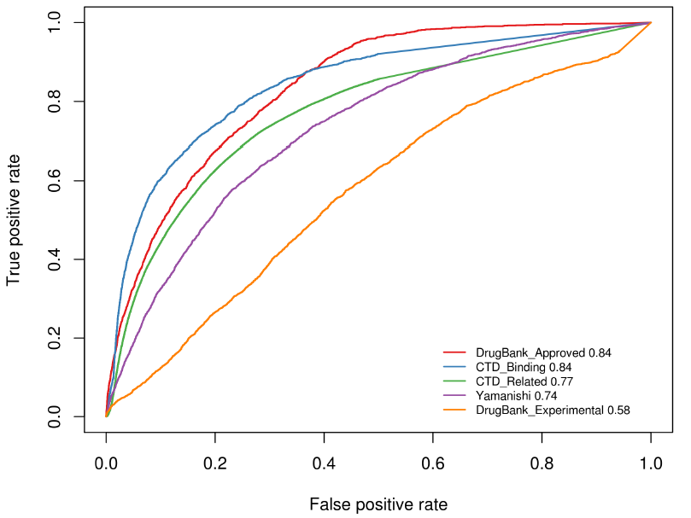
Application: Drug Repositioning; performance
M. Kissa, G. Tsatsaronis, M. Schroeder. “Prediction of drug-gene associations via ontological profile similarity with application to drug repositioning”, Elsevier Methods, In Press, 2015
19
  George Tsatsaronis, TDM in the Life Sciences, 03/11/2016, EC

