Slide 1
Innovations in Submission and Peer Review Systems
STM Future Lab
August 21, 2013
Anna Jester
Director of Sales & Marketing
eJournalPress

Slide 3
Where do we see peer review going?
Notes:
The Seventh International Congress on Peer Review and Biomedical Publication is being held September 8-10, 2013 in Chicago, Illinois, USA.
Topics include, but are not limited to, presentations relating to:
-Authorship
-Ethical Issues and Misconduct
-Bias
-Trial Registration
-Data Sharing and Availability

Slide 4
The Seventh International Congress on Peer Review and Biomedical Publication
September 8-10, 2013 in Chicago, Illinois, USA.
Topics include:
-Authorship
-Ethical Issues and Misconduct
-Bias
-Trial Registration
-Data Sharing and Availability
What will this mean for eJournalPress?
Notes:
What will this mean for peer review system providers?
-Collecting additional Authorship Information
-Helping store and track information relating to ethics
-Collecting forms
-Storing FundRef, Trial Registration, etc. information
-Allowing people to upload or link to data, confirm they will make data available

Slide 5
What Do Our Customers Want?
Integration
Variety has become the modus operandi
Publishers expect innovative integration between online editorial systems and other initiatives, tools, and platforms
Common implementation motivation
Notes:
One of my favorite saying sums up what we’ve come to expect from devices and systems in the current age. “My phone is only one of the applications available for use on this device.” And for me, it is not the application I use most frequently.
Peer Review systems need to work on tablets, and even iPhones. Rather than having an app for every phone OS and tablet, we use web screens which are tested and work in mobile devices allows users to utilize the system as they wish (whenever, wherever, etc.).
Publishers have come to expect their online systems will be able to integrate in innovative ways with other systems.

Slide 6
Some Recent Integrations
F
O
Data Harmony

Slide 7
FundRef Submission Question
Notes:
FundRef is a collaborative pilot project of scholarly publishers and funding agencies, facilitated by CrossRef, to provide a standard way of reporting funding sources for published scholarly research.

Slide 8
Auto-completion

Slide 9
Hierarchical Data / Parent Organizations
Parent Organization's “Short Name” pre-pended

Slide 10
Configuration Screens
Journal Staff FundRef configuration screen
Allows for download of latest FundRef XML file on demand
Local database updated to reflect FundRef XML file changes

Slide 11
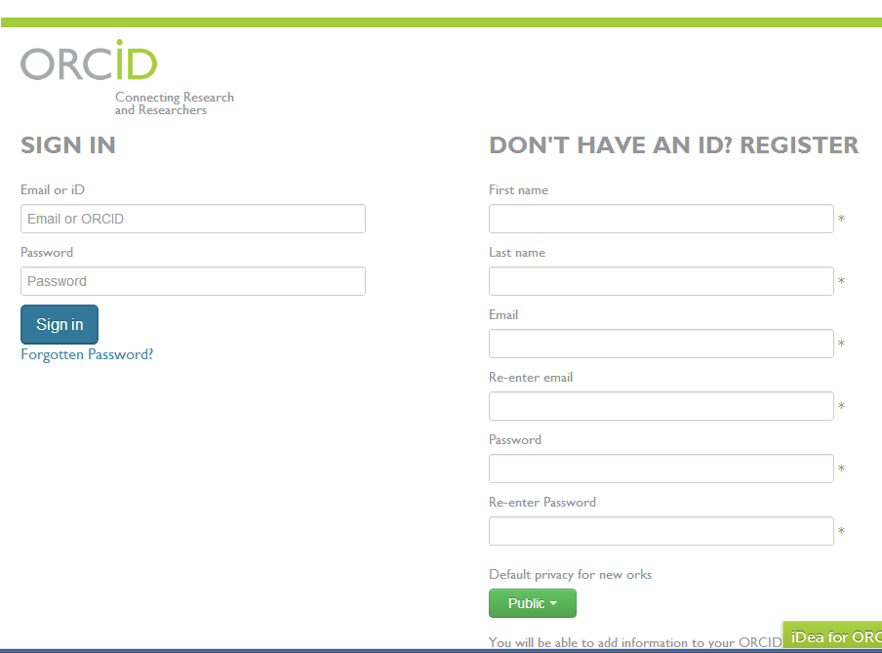
ORCID

Slide 12
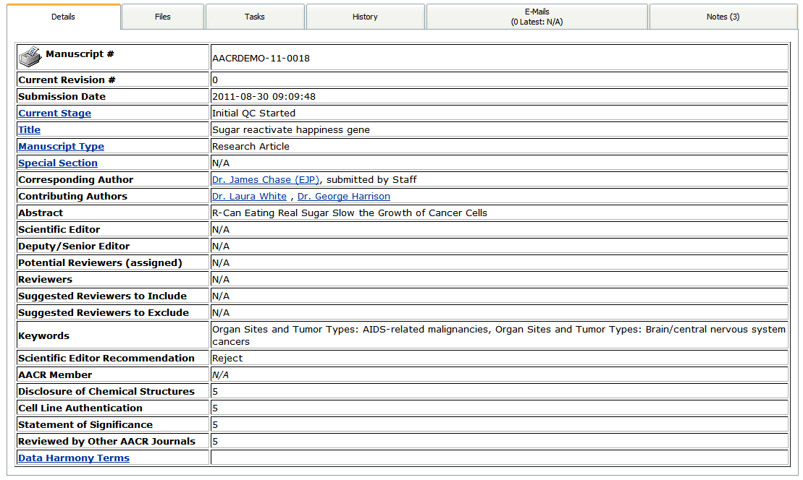
Data Harmony Integration
Notes:
“… provides knowledge management solutions to organize your information resources, based on a well-built and systematically applied taxonomy or thesaurus.

Slide 13
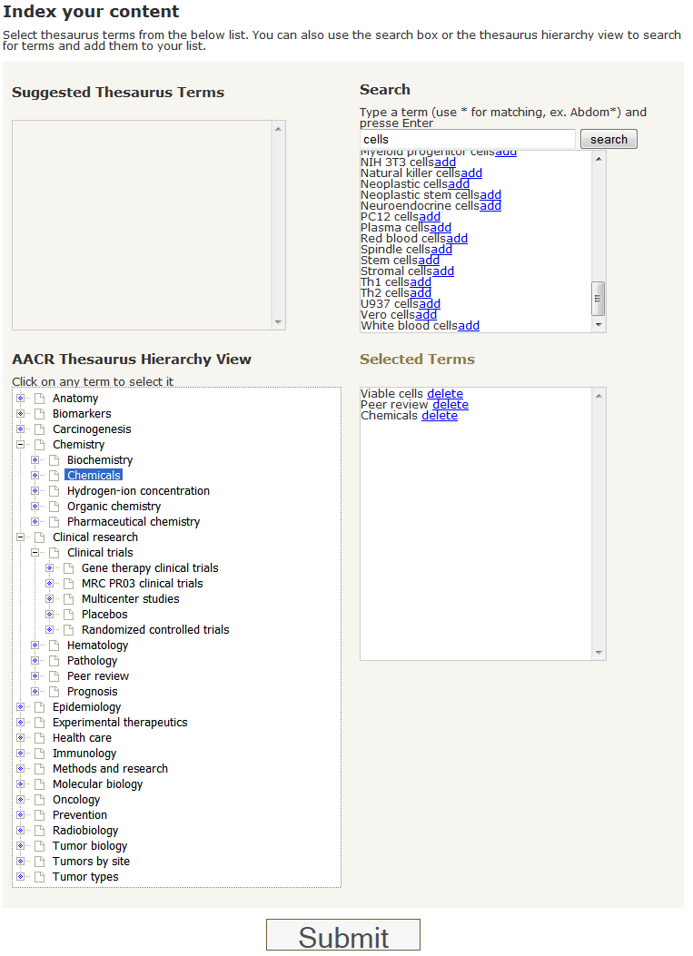
Data Harmony
Searching:
Type terms
Choose from selection list
Submit selected terms

Slide 14
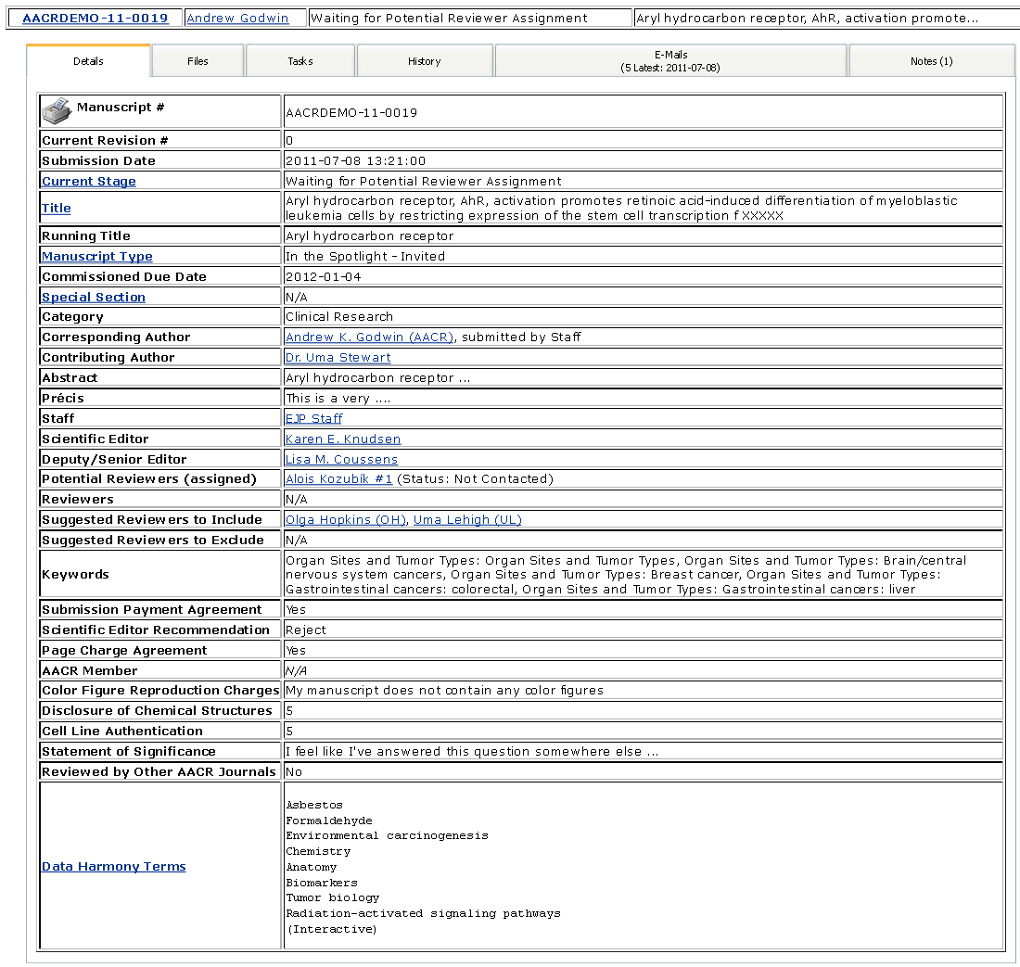
Data Harmony Interactive Results

Slide 15
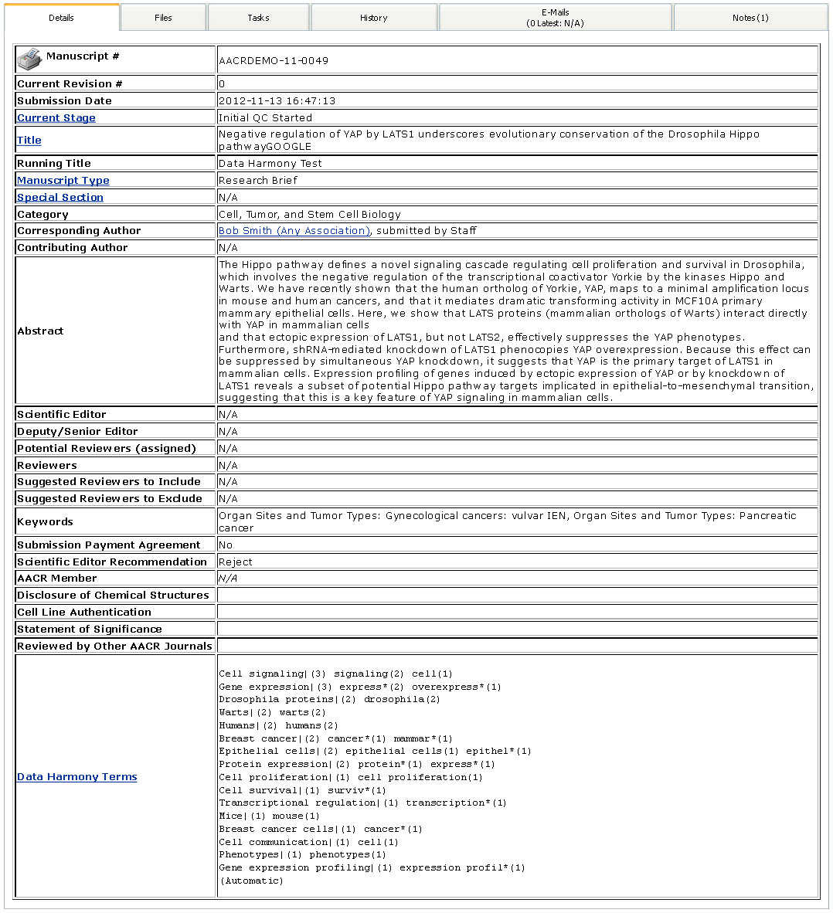
Data Harmony Automatic Results

Slide 16
Customers Are Also Asking For:
Exporting Reviews (to be published)
Aiding Discussion of Decision Letters
Look and Feel Customization
Open Access Questions
Payment Options
Varied Licenses / Disclosures
One-off Functionalities

Slide 17
Peer Review of Video, Audio, Data Sets
Variety of Viewpoints
Sometimes Discipline Specific

Slide 18
Thank You For Your Time!
Anna Jester
Director of Sales & Marketing
eJournalPress
ajester@ejpress.com
+1 301.230.7601

